Slide 1
1st Call LP seminar
How to report on indicators
Belgrade – 24-25 April, 2024
Natalia Liholot
Notes:
Title slide should include the title of the presentation, the presenter’s name, the date, place and name of the event.

Slide 2
Indicators – points of attention
In the frame of the programme intervention logic the programme output indicators are linked to the programme result indicators, which is presented in the table.
What are RCO, RCR and ISI?
RCO is an output indicator. RCR is a result indicator taken from the Regulation and ISI (Organisations with increased institutional capacity due to their participation in cooperation activities across borders) is a result indicator which is not taken from the Regulation but defined by INTERACT together with transnational programmes.
3 important things to remember when reporting on indicators:
Number
Measurement unit
Description
Notes:
Agenda slide should outline the structure of the presentation and provide an overview of the topics or sections that will be covered.

Slide 3
How to report on mandatory indicators (1)
Output indicator
Result indicator
RCO 87 Organisations cooperating across borders
ISI: Organisations with increased institutional capacity due to their participation in cooperation activities across borders
It counts the number of PPs+ASPs
as mentioned in the application form
and subsidy contract.
Measures the number of organisations that actively participated in cooperation activities of a project across borders and consequently increased their institutional capacity.
An organisation is to be counted no more than once per project regardless of how many activities it was involved in or how many departments were involved.
An organisation is to be counted if it has undergone this kind of learning process through project activities. This is defined as more than one instance of tangible exchange in which the organisation played an active role.
An organisation is to be counted only if its increased institutional capacity is in the thematic field of the project.
An organisation that is involved in the project partnership (LP, PPs, ASPs) are to be counted for this result indicator, if the result indicator is linked to the output indicator RCO87 (cooperation across border).
An organisation, which actively took part in a project pilot action and increased their institutional capacity in the thematic field of the project, but not involved in the project partnership shall be counted for this indicator, if it is linked to the output indicator RCO84 (joint pilot actions).
Notes:
Section header slide is used to introduce new sections or topics within the presentation. It includes a number of the section, title and may also include a short description of the upcoming section.

Slide 4
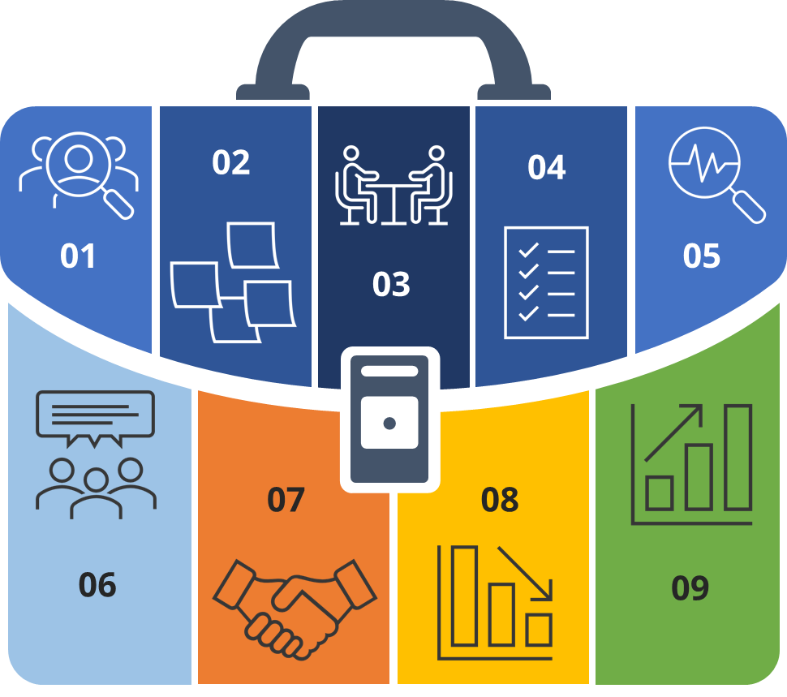
How to report on mandatory indicators (2)
Result indicator
ISI: Organisations with increased institutional capacity due to their participation in cooperation activities across borders
Collection of data:
Data for this indicator is to be collected via a survey provided by the programme to the project lead partner.
- The project may decide to translate the survey into local languages if necessary. The project lead partner is responsible for ensuring that the survey is completed by the organisations that participated in project activities. The lead partner is responsible for collecting the responses in an overview table that it provides to the programme.
- The programme is responsible for verifying the consistency of the aggregated data in the overview table provided by the programme. The programme is not responsible for verifying the accuracy of the data at the level of the individual organisations.
Notes:
Section header slide is used to introduce new sections or topics within the presentation. It includes a number of the section, title and may also include a short description of the upcoming section.

Slide 5
How to report on mandatory indicators (3)
Result indicator
ISI: Organisations with increased institutional capacity due to their participation in cooperation activities across borders
Survey template – for ISI
(sample only)
[Preamble]
Identification
Your name and surname: ________________________________
E-mail address: ________________________________________
Organisation name: _____________________________________
Country: ______________________________________________
Status in project:
☐ LP/PP
☐ Associated strategic partner
☐ Other stakeholder
Notes:
Section header slide is used to introduce new sections or topics within the presentation. It includes a number of the section, title and may also include a short description of the upcoming section.

Slide 6
How to report on mandatory indicators (4)
Result indicator
ISI: Organisations with increased institutional capacity due to their participation in cooperation activities across borders
Did the institutional capacity of your organisation increase as a result of involvement in this project?
☐ Yes
☐ No / Not sure
If you answered 'Yes': How has your organisation changed? Select all that apply.
☐ Used new knowledge or skills
Please describe: _____________________________________________
☐ Adopted new tools
Please describe: _____________________________________________
☐ Adopted new procedures or workflows
Please describe: _____________________________________________
☐
Notes:
Section header slide is used to introduce new sections or topics within the presentation. It includes a number of the section, title and may also include a short description of the upcoming section.

Slide 7
How to report on mandatory indicators (5)
Result indicator
ISI: Organisations with increased institutional capacity due to their participation in cooperation activities across borders
Changed the organisational structure
Please describe: _____________________________________________
☐ Other
Please describe: _____________________________________________
If you answered “No”: what were the factors that lead to failure in increasing the institutional capacity? Select all that apply form the following:
☐ Unclear information received;
Please describe: _____________________________________________
☐ No new information, tools etc. provided;
Please describe: _____________________________________________
☐ Lack of consistent participation in the project;
Please describe: _____________________________________________
☐ Other, please specify.
Please describe: _____________________________________________
☐
Notes:
Section header slide is used to introduce new sections or topics within the presentation. It includes a number of the section, title and may also include a short description of the upcoming section.

Slide 8
How to report on indicators
Programme indicator RCO 84 - Pilot actions developed jointly and implemented in projects
ISI: Organisations with increased institutional capacity due to their participation in cooperation activities across borders, other than organisations counted under RCO 87 Organisations cooperating across borders (PPs, etc.) – e.g. organisations external to the partnership
RCO 116 Jointly developed solutions
RCR 104 Solutions taken up or up- scaled by organisations
Notes:
Section header slide is used to introduce new sections or topics within the presentation. It includes a number of the section, title and may also include a short description of the upcoming section.

Slide 9
How to report on indicators - Output indicator RCO 84
Jointly developed pilot action has an experimental nature either testing of innovative products, methodologies, tools etc. or demonstrating the application of existing products, methodologies, tools to a certain territory/sector; the feasibility and effectiveness of procedures, new instruments, tools, experimentation or the transfer of practices.
In order to be counted by this indicator, the pilot action needs not only to be developed, but also implemented within the project and the implementation of the pilot action should be finalised by the end of the project.
Programme indicator RCO 84 - Pilot actions developed jointly and implemented in projects
Jointly developed pilot action implies the involvement of organisations from the partnership in its implementation. The concept and implementation details of the pilot actions have to be jointly developed by the partnership, even though its implementation can be individual in certain partner regions.
Carrying out project activities in a certain “pilot area” without testing, or demonstrating a solution is not considered as pilot action and not to be counted under this indicator.
Notes:
Quote slide features a quote or statement relevant to the presentation topic.

Slide 10
How to report on indicators - Output indicator RCO 116 Jointly developed solutions
What it measures?
The indicator counts the number of jointly developed solutions from joint pilot actions implemented by supported projects.
Practical implementation of the indicator:
In order to be counted in the indicator, an identified solution should include indications of the actions needed for it to be taken up by the target group or to be up scaled.
Each developed solution of the project shall be counted only once under the respective output indicator.
In case a solution (e.g. a methodology) is jointly developed by the project, but not pilot tested and validated within the project to be feasible and applicable (see RCO84), then that product of the project shall not be counted under this output indicator.
Project management-related tools, like internal communication platforms, templates should not be considered under this output indicator.
Definitions:
Jointly developed solution contributes to solve a common problem, challenge addressed by the project. The joint solution shall be pilot tested (RCO84) to prove whether the solution meets the needs of the target groups.
The forms of solutions can be very diverse, tools (e.g. analytical, monitoring, management, decision making tools, instruments), technologies (software, ICT solutions, platforms), methodologies, concepts, guidelines, processes, agreements, services etc.
A jointly developed solution implies the involvement of organisations from the partnership in the drafting design and evaluation process of the solution.
Notes:
Quote slide features a quote or statement relevant to the presentation topic.

Slide 11
How to report on indicators - Result indicator RCR 104 Solutions taken up or upscaled by organisations
What it measures?
The indicator counts the number of solutions, other than legal or administrative solutions, that are developed by supported projects and are taken up or up-scaled during the implementation of the project or within one year after project completion
PILOT
SOLUTION
Definitions: ✓
Joint solutions taken up by organisations means that the solution developed jointly by the partnership is adopted and applied by its target group (documented by the adopting organisations in, for instance, strategies, action plans etc.) already before, or until the submission of the final report (3 months from the end of project implementation).
In case the solution is finalised at the end of the projects and thus its uptake will happen after project finalisation, the lead partner shall provide, together with the last progress report a time plan for the uptake of the solution in practice (by organisations within the partnership and or outside the partnership). ✓
The organisations involved in take-up means those target groups who are expected to adopt and apply the developed solution, which organisations may or may not be direct participants (LP, PP, ASP) in the supported project.
Notes:
Quote slide features a quote or statement relevant to the presentation topic.

Slide 12
How to report on indicators
Output indicator
Result indicator
RCO 83 Strategies and action plans jointly developed
RCR 79 Joint strategies and action plans taken up by organisations
Notes:
Quote slide features a quote or statement relevant to the presentation topic.

Slide 13
How to report on indicators - Programme output indicator RCO 83 Strategies and action plans jointly developed
What it measures?
A jointly developed strategy or action plan implies the involvement of organisations from the partnership in the drafting process of the strategy or action plan. The involvement of the relevant stakeholders is also crucial, since the strategy, or action plan shall reflect the needs of these stakeholder groups and ensure its sustainability and future implementation.
The indicator counts the number of joint strategies or action plans developed by supported projects.
A joint strategy/action plan is to be counted if it is developed by the project, while revision or update of existing strategies/action plans cannot be counted under this indicator. ✓
Each developed strategy/action plan of the project shall be counted only once under the respective output indicator. ✓
In case a strategy is developed by the project and based on that also action plan(s) are developed within the same project, these are to be counted separately for this indicator. ✓
Project management and communication-related strategies such as e.g. the project communication strategy, should not be considered under this output indicator. ✓
Guidelines, policy recommendations and other similar documents of strategic relevance, but not being strategy/action plan shall not be counted under this output indicator.
Notes:
Quote slide features a quote or statement relevant to the presentation topic.

Slide 14
How to report on indicators - Programme indicator RCR 79 Joint strategies and action plans taken up by organisations
What it measures?
How to report
The indicator counts the number of joint strategies and action plans (not individual actions) adopted and implemented by organisations during or after the project completion.
At the time of reporting this indicator, the implementation of the joint strategy or action plan does not need to be completed but effectively started. ✓
It is not necessary that the implementation of the strategy/ action plan is fully finalised in order to count the indicator. ✓
Together with the final progress report the lead partner shall provide the MA/JS with the timespan of strategy/ action plan implementation, timetable that should cover at least one year after the project end
Joint strategies and action plans taken up by organisations means that the elaborated strategy/action plan is endorsed and applied by its target group and the implementation of at least certain parts of the strategy/action plan already starts during project implementation or until the deadline of submission of the final progress report (three months after the project end). ✓
The organisations involved in take-up means those target groups who are expected to apply and implement the elaborated strategy / action plan, which organisations may or may not be direct participants (PP, ASP) in the supported project
Notes:
Quote slide features a quote or statement relevant to the presentation topic.

Slide 15
How to report on indicators –RCO82 - RCR85
Output indicator
Result indicator
RCO82 Participations in joint actions promoting gender equality, equal opportunities and social inclusion
RCR85 Participations in joint actions across borders after project completion
Indicators applicable only to Priority 3 SOs 3.1 and 3.2
What it measures?
What it measures?
The indicator counts the number of participations in joint activities principally addressing horizontal principles (gender equality, equal opportunities and social inclusion) implemented in the supported projects.
Joint actions could include, for instance, exchange activities or exchange visits.
The indicator counts the number of participations in joint actions across borders after the completion of the project, organised by all or some of the former partners or associated organisations within the project, as a continuation of cooperation ✓
For the definition of this indicator, the joint action includes training schemes.
Participations (i.e. number of persons attending a joint action) are counted for each joint activity organised on the basis of attendance lists or other relevant means of quantification. ✓
A joint action is considered an action organised with the involvement of the project partners (from the definition of the content to its practical implementation). ✓
Participations in public events promoting gender equality, equal opportunities and social inclusion, organized in supported projects, should not be counted in this indicator.
Joint actions across borders could include, for instance, exchange activities or exchange visits organized with participants from at least three countries of the programme area.
Participations (i.e. number of persons attending a joint action across borders) are counted for each joint action organised on the basis of attendance lists or other relevant means of quantification.
Result indicator has to be realistically considered: maybe not all the participants in the study visits during project implementation will continue also after but only e.g. half or three quarters.
Notes:
Quote slide features a quote or statement relevant to the presentation topic.

Slide 16
RCO120 - Projects supporting cooperation across borders to develop urban-rural linkages – no result indicator
It is valid only for SO 4.2
Time of measurement for achievement
- Upon project finalisation
What it counts?
The indicator counts the number of projects which aim, as a primary objective, to enhance the cooperation across borders between urban and rural areas.
The indicator should be counted by the project only if by general approach or at least one specific objective of the project is addressing the developing of urban-rural linkages. Since the indicator is counting the number of projects, if selected by the LA, the target value will always be 1.
Definitions
Understanding rural-urban linkages provides the basis for measures that can improve both urban and rural livelihoods and environments.
Notes:
Content slide used for presenting information.

Slide 17
Danube Region Programme
Managing Authority/ Joint Secretariat
Natalia Liholot, Project Officer
1065, Budapest,
Nagymező u. 44
natalia.liholot@interreg-danube.eu
+36 30 094 5726
https://www.linkedin.com/in/interregdanube/
https://www.facebook.com/InterregDanube/
Notes:
Thank you slide including the the contact information.

