Slide 1
1st Call LP seminar
Partner Report – Project Progress Report
Belgrade – 24-25 April, 2024
Mirjana Arsenic Petrovic
Natalia Liholot
Horst Schindler
Notes:
Title slide should include the title of the presentation, the presenter’s name, the date, place and name of the event.

Slide 2
Indicative contents
When to report?
How to report?
Why to report?
Hints and tricks
Notes:
Agenda slide should outline the structure of the presentation and provide an overview of the topics or sections that will be covered.

Slide 3
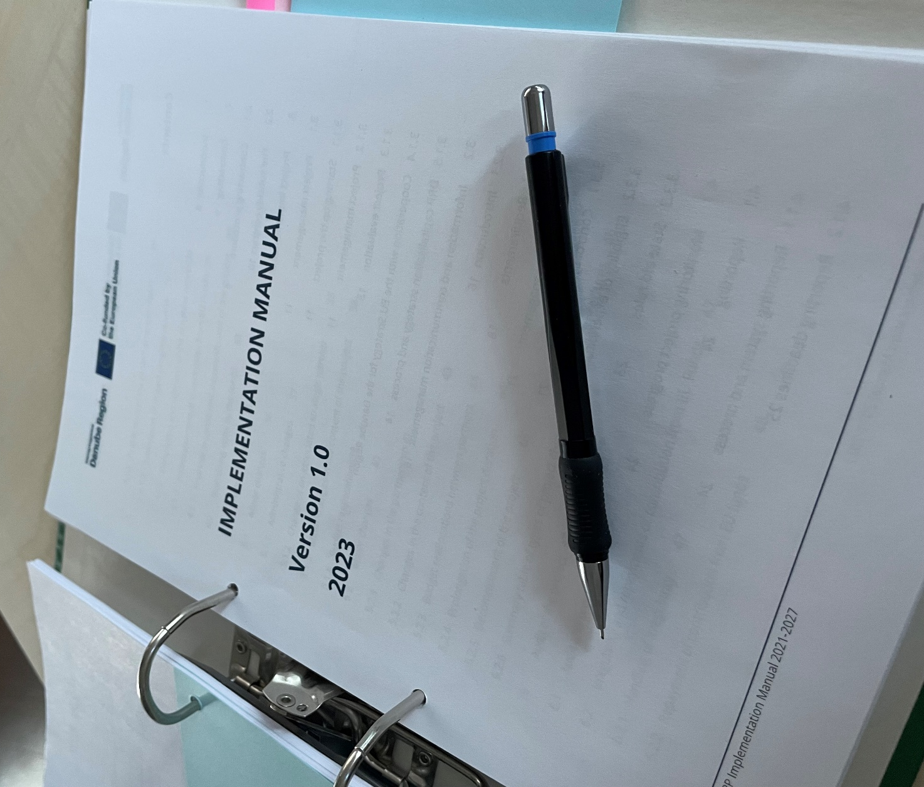
Crash course: Implementation Manual Chapter 4 Monitoring project progress p 30 ff

Slide 4
Crash Course (Parts 2 & 3) sent out on Friday, April 19th 2024 published on the website since Monday April 22nd 2024

Slide 5
Spending Forecast SC Article 5: Reporting obligations and payment The reporting periods and the deadlines for submission of the PPR and AfR of the project are the following:
Period ID | Reporting period (dd/mm/yyyy- dd/mm/yyyy) | Deadline for submission of the Project Progress Report and Application for Reimbursement (dd/mm/yyyy)
period 1 | 01.01.2024 – 30.06.2024 | 01.10.2024
period 2 | 01.07.2024 – 31.12.2024 | 01.04.2025
period 3 | 01.01.2025 – 30.06.2025 | 01.10.2025
period 4 | 01.07.2025 – 31.12.2025 | 01.04.2026
period 5 | 01.01.2026 – 30.06.2026 | 01.10.2026

Slide 6
IM 4.1.7 Financial progress and decommitment of the project (SC Article 14) The Partnership has the possibility to deviate from the spending forecast laid down in the SC taking into consideration that in case of underspending (with reference to the original spending forecasts) the MA/JS is entitled to decommit the budget of the project by reducing the original project budget and the corresponding contribution from Interreg Funds (based on the prior decision of the MC). In case the LP submits the PPR and the AfR or the project modification request with unjustified delays, or more than two completions of the same PPR and AfR are attributable to the LP, the MA/JS is entitled to apply a proportional reduction of the total project budget up to 5% on the basis of the decision of the monitoring committee.

Slide 7
Timeframe for management verification
Verification process | Verification timeframe and indicative deadlines
Preparation and submission of the PR by the project partner to the controller from the end of each reporting period | 15 days
Verification of expenditure and issuing the control certificate by the controller |  | 60 days
Preparation and submission of the PPR and the AfR for the whole project by the lead partner to the MA/JS |  |  | 15 days

Slide 8
Timeframe of reimbursement
Reporting period 6 months
Submission of the PPR and AfR by LP 3 months
Checking the PPR and AfR by MA/ JS
30 days
Payment procedure CA
10 days

Slide 9
https://jems.clarmont.hu/

Slide 10
Typical errors in Partner reports
invoice number not filled in
invoice date/payment date not filled in
Reported costs with the payment date after the end date of the reporting period
description written in national language
Registration fees for participation in events reported under Travel and accommodation (real cost option) instead of External expertise cost category
Stakeholders’ travel and accommodation costs reported under Travel and accommodation (real cost option) instead of External expertise cost category
Travel costs of ASP reported under External expertise instead of Travel and accommodation cost category
Costs of stamp, postal services reported under BL External expertise instead of BL Office and administration
Costs of spare parts, fuel, oils for equipment shall not be reported under External expertise and services cost category
Cost of renting of the project equipment (listed in AF under cost category Equipment) shall be reported under cost category Equipment

Slide 11
Application for Reimbursement (AfR)
Before generating please check if:
List of partner certificates- all wanted Control certificates are included
Contracting/ partner details- Bank details of lead partner are up-to-date (latest Annex 2 Bank account statement uploaded)
AF/ B-Project partners/ Contact/ B.1.4 Legal representative data is up-to-date
Generating AfR
Project progress report/ Report exports/ AfR generation
Project progress report annexes
Upload printed, signed and scanned AfR

Slide 12
Danube Region Programme
Managing Authority/ Joint Secretariat
Thank you for your attention!
https://www.linkedin.com/in/interregdanube/
https://www.facebook.com/InterregDanube/
Notes:
Thank you slide including the the contact information.

