Slide 1
^{Danube Region Strategy}
^{PA7 Knowledge society}
Lead Partners Seminar, 25 April 2024, Belgrade
Jaroslava SZUDI, PA7 coordination team

Slide 2
Danube Region Strategy
The EU Strategy for the Danube Region (EUSDR) is one of macro-regional strategies adopted by the European Commission in December 2010 and endorsed by the European Council in 2011.
The Strategy was jointly developed by the Commission, together with the Danube Region countries and stakeholders, in order to address common challenges together.
The Strategy seeks to create synergies and coordination between existing policies and initiatives taking place across the Danube Region.
The Strategy is not about funding, it is about closer cooperation!

Slide 3
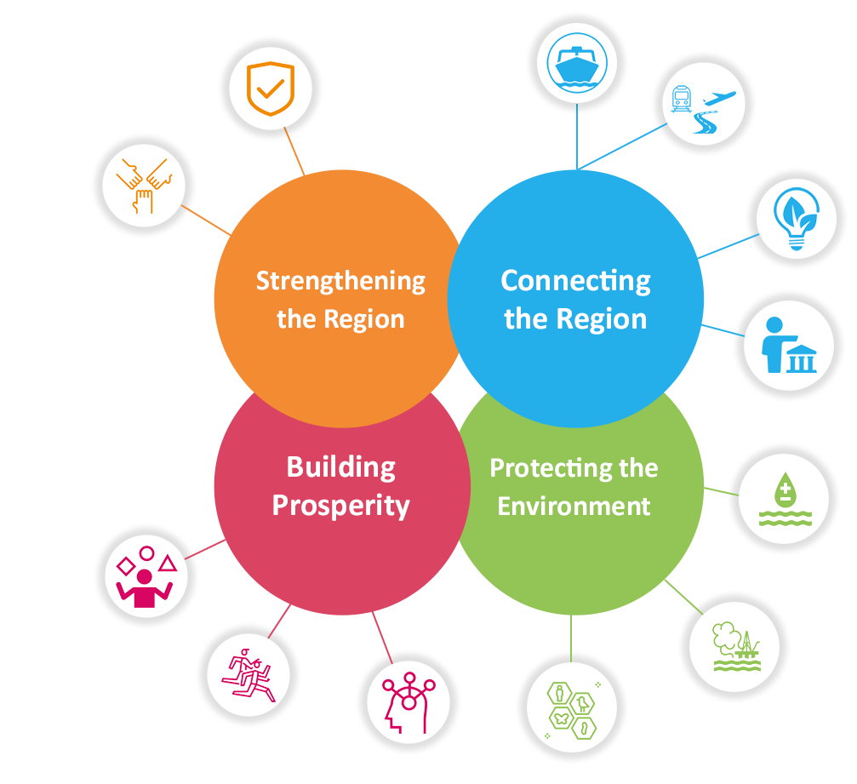
Danube Region Strategy – priority areas
The Danube Region Strategy addresses a wide range of issues divided among 4 pillars and 12 priority areas.
Each priority area is managed by two countries as Priority Area Coordinators (PACs).
More information: https://danube-region.eu/about/priority-areas/

Slide 4
PA7 „Knowledge Society“ approach towards the EUSDR Action Plan
PA7 supports development of the knowledge society via education, research and ICT elements
horizontal character; cross-cutting priority area
higher education, research and innovation are not only highly relevant issues per se, but they also form an integral and essential part of other priorities; from energy, water and environment, to culture and security

Slide 5
PA7 „Knowledge Society“ appreciated the establishement of the Capitalisation Strategy
Capitalisation Strategy enables synergy building between the DRP projects, and/or other projects funded by other financial instruments
Via the capitalisation activities you can:
get to know each other’s work,
establish professional links in order to cooperate,
help and learn from each other, grow together,
score better outcomes and results through peer learning, benchmarking, etc.

Slide 6
How did the “capitalisation” look like?
regular meetings of the projects within thematic poles
PAs supported the regular pole meetings + project leaders attend PA SG meeting - exchange knowledge, inform about progress, learn about possible opportunities leading to action (preparation of analyses, joint events, round tables, policy initiatives, dissemination of information)

Slide 7
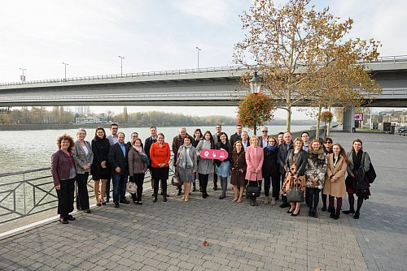
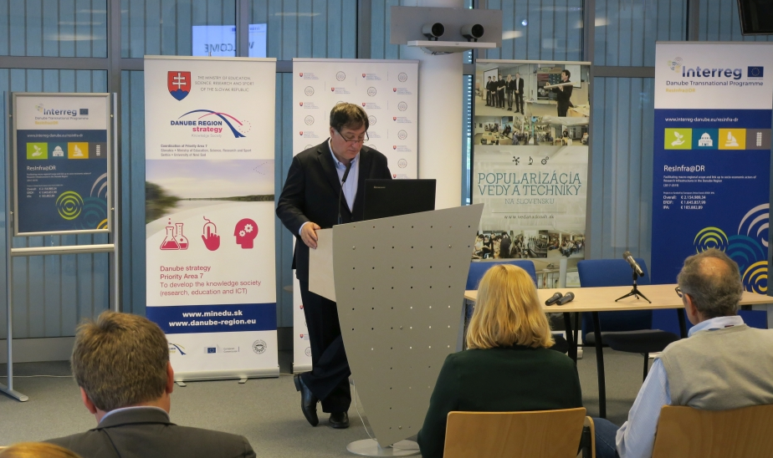
PA7 „Knowledge Society“ using the Capitalisation
support by preparing surveys, reports, studies
analyses on RI prepared, communicated and discussed on policy level
common surveys organized on the needs of young project mangers
new legislation on dual education adopted
hundreds of young people trained on the project preparation/implementation
better visbility of the projects
joint calls and mobility schemes ongoing
new study programmes prepared
fostered national reforms on dual education
innovation trackers and matchmaking platforms created

Slide 8
Why is it good to capitalise?
to foster linkages between projects related to similar topics (within thematic poles);
to create a higher leverage effect by enabling projects to exploit and consolidate one another’s achievements;
to fill knowledge-gaps by linking actors with complementary thematic specialisation, experience, methodological approaches or geographical scope;
to increase the visibility and impact of both projects and Programme and ensure impact on the policy making process;
to reinforce the links between the Programme and the Strategy and foster the capitalisation opportunities.

Slide 9
For more information
www.danubeknowledgesociety.eu
facebook.com/DanubeKnowledgeSociety
#DanubeKnowledgeSociety
@EUSDR_knowledge

