Slide 1
SMF call LP seminar
Project implementation and communication
On-line – 6 November, 2024
Simona Ene
Michal Pavlik
Horst Schindler
Árpád Kovács
Notes:
Title slide should include the title of the presentation, the presenter’s name, the date, place and name of the event.

Slide 2
START DATE: 1st September 2024
Summary of project implementation: March 2025
Project end:
31 August 2025
PPR submission: 1st December 2025
Notes:
Agenda slide should outline the structure of the presentation and provide an overview of the topics or sections that will be covered.

Slide 3
Summary of project implementation
To be submitted by 15 March 2025
Progress in developing the outputs
Delays and plans for recovery
Notes:
Agenda slide should outline the structure of the presentation and provide an overview of the topics or sections that will be covered.

Slide 4
Communication
Seed Money Facility call webinar
Online, November 6, 2024
Michal Pavlík

Slide 5
Checklist
Project logo
Project poster
Social media
Copyright and licences

Slide 6
Checklist
Use the project logo prominently across all your project communication materials, printed and digital.
Acknowledge the support from Interreg Danube Region Programme across all project materials.
Ensure that every project partner displays a project poster at their premises and promotes the project on their websites.
Make sure that each partner presents the project on their official website.
Install a permanent billboard or plaque when the expenditure on a physical investment or equipment purchase surpasses EUR 100,000.
All projects approved within the Interreg Danube Region Programme are required to adhere to our branding and communication requirements.

Slide 7
Project logo
2
The MA/JS supplies every project with the project logo package. The project logo incorporates the programme logo, which includes the EU emblem and funding statement used for promoting all EU-funded projects. Additionally, it features the programme's name along with reference to Interreg and your project's acronym with the colour of the relevant programme’ priority, unified into a single logo.

Slide 8
Project brand book and communication guidelines - https://interreg-danube.eu/toolkit/communication
The EU emblem must be prominent (size and placement) across all project materials – public as well as for project participants.
Must be accompanied by the co-funding statement.

Slide 9
a
You may use different versions on different materials, depending on the design.
Color/contrast.
No changes allowed – all elements must stay the same.

Slide 10
a

Slide 11
Project poster
3
Each project partner is required to display a poster or equivalent electronic display containing project information in a publicly visible location, such as the entrance of a building and stay visible for the whole duration of the project

Slide 12
Project brand book and communication guidelines - https://interreg-danube.eu/toolkit/communication
The MA/JS provides projects with a basic poster template (A). However, this template may not perfectly fit all projects, particularly if the project full name is not self-explanatory. In such cases, you can use the template (B) with extra text block for short project description or create your own design by modifying the templates but respecting the minimum requirements.
The poster’s design must be of a minimum size of A3 and should include, at a minimum, the project logo, project acronym and full project name, details regarding the project budget (total project budget in EUR, Interreg funding in EUR) information on project duration and contact details (name of the institution and contact person and e-mail address) as well as the acknowledgement of the co-funding provided by the European Union, for example:
This project is supported by the Interreg Danube Region Programme co-funded by the European Union.

Slide 13
Social media
5
We highly recommend using social media as a means of engaging with stakeholders and sharing project-related information. The programme actively tracks social media activity and acts as an amplifier for disseminating project information to maximize its impact.

Slide 14
If the platform you are using allows, incorporate the complete project logo into the social media banner image. Alternatively, if the platform does not support banner images, utilize the full project logo as your avatar.

Slide 15
Copyrights
6
It is the responsibility of project partners to respect all copyrights or license agreements when any materials – photos, illustrations, videos, graphic elements, presentations, etc. – are made publicly available, e.g. uploaded to the project website and/or social media channels.

Slide 16
Photo copyrights
As part of this, you must add reference to provide credit to the author or the owner of the photo, video, etc. For example, by identifying the photographer directly on or below the image. Any violations of content copyright or license agreements are the sole responsibility of your partnership, including legal liability and the project partnership is responsible to pay potential penalties.
GDPR
Whenever individuals can be identified by their image, data protection legislation applies. In these situations, the rights of the individuals in the collection and use of their photographs must be respected – they must be informed when an identifiable image of them will be or has been captured, and a legal basis (e.g. ‘legitimate interest’, ‘consent’ and ‘contractual obligation’) must be found before the image is used in any way. If there are no other legal basis available, project partnerships have to make sure to have the consent of the person, of whom the picture is taken. Consent is valid when it is made in writing and consent forms need to be stored until the photo is used. In all situations the data subjects need to be informed what you intend to do with the photographs, including whether they will be published on the internet.
Examples of consent notices or disclaimers related to GDPR (General Data Protection Regulation) compliance. They inform individuals that photographs will be taken and used for specific purposes, and they obtain consent for the use of these images.
General event notice:
Please be informed that photographs will be taken during this event for use on our website and social media channels. By participating in this event, you consent to your image being used for these purposes.
Specific consent form:
We would like to take photographs of you during this event for our website and social media. By signing this form you agree to have your image used in this manner. Thank you for your cooperation.

Slide 17
Requirement to share all materials
Upon request, project partnership must make the project publicity and visibility materials available to the Interreg Danube Programme as well as any EU institution. The materials must be delivered with a royaltyfree, non-exclusive, and irrevocable license to use such material. You must grant any pre-existing rights to the European Union in accordance with Article 49 (6) and Annex IX of the Common Provisions Regulation (EU 2021/1060).

Slide 18
Thank you for your attention!

Slide 19
SMF call LP seminar
Partner Report – Project Progress Report
On-line – 6 November, 2024
Horst Schindler
Árpád Kovács
Notes:
Title slide should include the title of the presentation, the presenter’s name, the date, place and name of the event.

Slide 20
Indicative contents
When to report?
How to report?
Why to report?
Hints and tricks
Notes:
Agenda slide should outline the structure of the presentation and provide an overview of the topics or sections that will be covered.

Slide 21
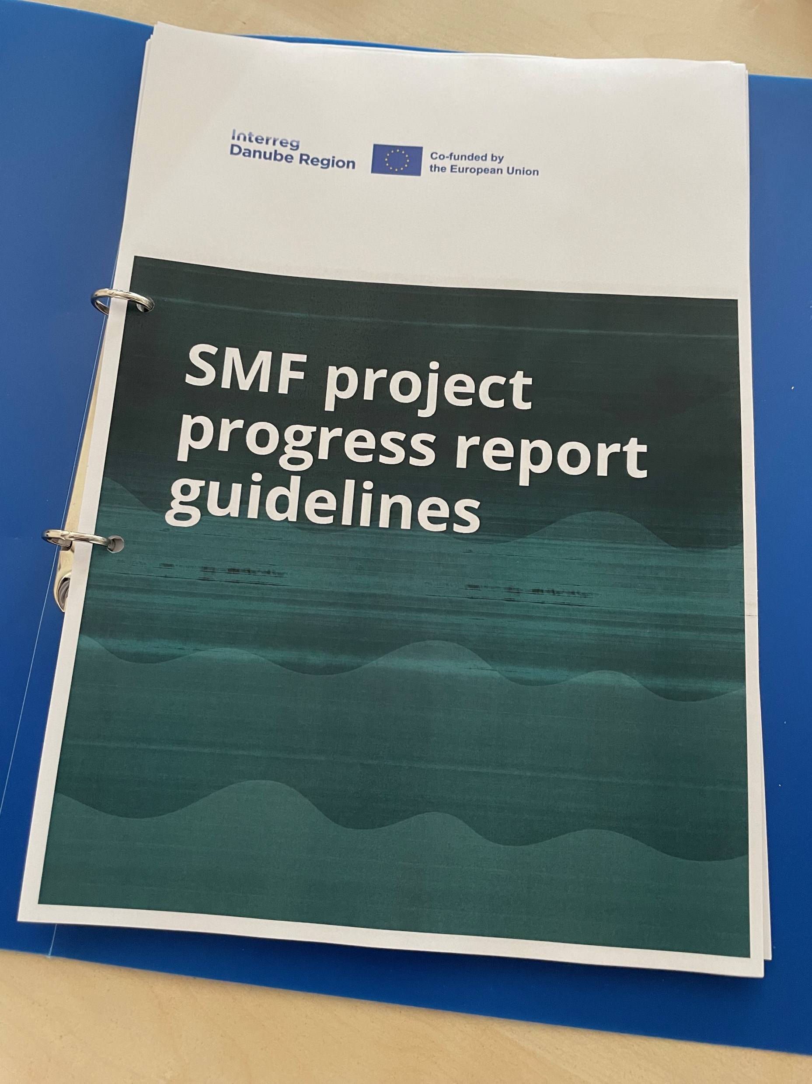
SMF Programme Manual Chapter II.3 Reporting

Slide 22
SMF partner report guidelines SMF project progress report guidelines

Slide 23
SMF Call
Project implementation between 01.09.2024 - 31.08.2025
Deadline for submitting the „midterm” report: 15.03.2025
Deadline for submitting Partner Reports: 15.09.2025
Deadline for submitting Project Progress Reports: 01.12.2025
Earlier project end and report submissions are possible

Slide 24
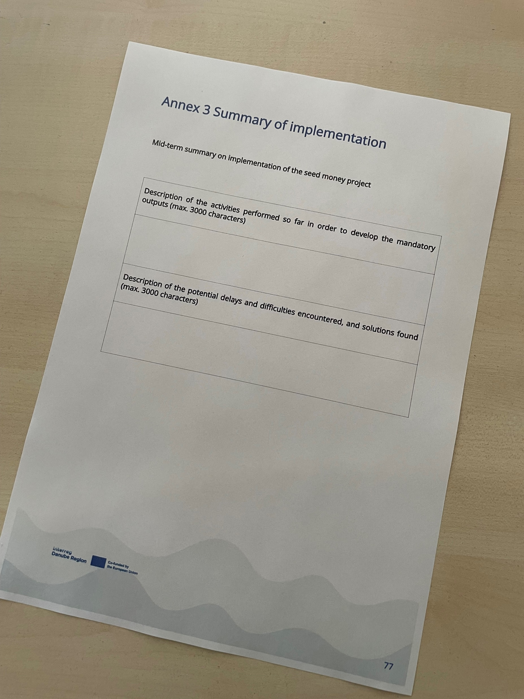
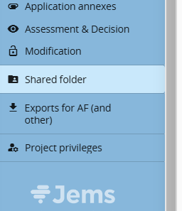
„Midterm” report
Deadline:15.03.2025
Description of activities
Description of potential delays
Jems upload to the „Shared folder”

Slide 25
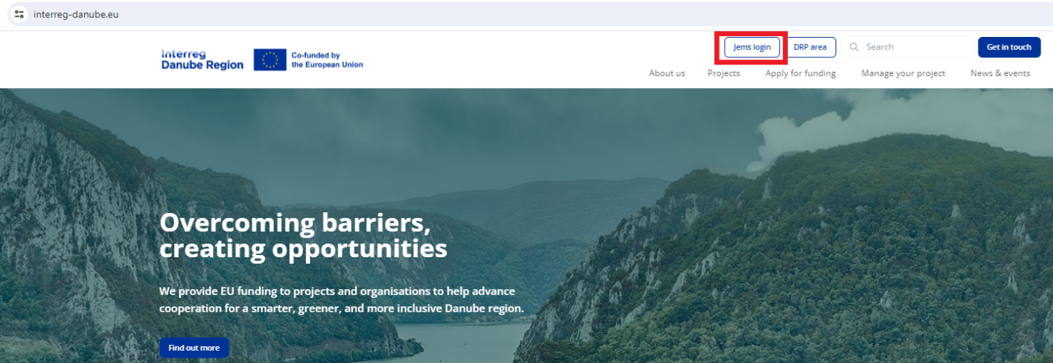
One stop shop for LPs and for PPs
www.interreg-danube.eu
Use JEMS for project management

Slide 26
SMF Call
Only one reporting period covering the entire project implementation
(01.09.2024 - 31.08.2025)
Upon Project activities are finished and the project is implemented:
Create Partner reports – 1 partner report per partner
Submit PRs to national controls
Generate the Project Progress Report – 1 PPR
Generate the AfR (application for reimbursement)
Submit the PPR

Slide 27
Timeframe for PRs -Partner Reports
Verification process | Verification timeframe and indicative deadlines
Preparation and submission of the PR by project partners to the national control at the end of the project | 15 days
Verification of expenditure and issuing the control certificate by the national control |  | 60 days
Preparation and submission of the PPR and the AfR for the whole project by the lead partner to the MA/JS |  |  | 15 days

Slide 28
Timeframe for PPRs - Project Progress Report
Verification process | Verification timeframe and indicative deadlines
Preparation and submission of the PPR by the LP | 3 months
MA/JS verification |  | 30 days
Reimbursement to projects |  |  | 10 days

Slide 29
Partner Reports
- SMF Programme Manual
- SMF partner report guidelines
Staff costs are reported on a real cost basis – observe the SMF Programme Manual for eligibility details
Inccured between 01.09.2024 and 31.08.2025
Paid between 01.09.2024 and 30.10.2025
Other expenditures covered as 40% flat rate to Staff costs – no supporting document needed

Slide 30
Staff costs
- Full time meaning 100% of time worked on the project
Part time – fixed percentage of the time worked – can be updated only once during the entire project implementation period
(reporting based on workhours is not possible)
In case there is a need to update more than once the percentage of time worked ask for prior approval from MA/JS PO/FO. If approved, attach the MA/JS feedback to supporting documents in JEMS
Reporting Staff costs in JEMS
If needed, group expenditures as per the guidence in the SMF Partner report guidelines (group expenditures per person)
Insert the payment date (between 01.09.2024 – 30.10.2025)
Attach supporting documents (zip in case of multiple documents)

Slide 31
National control of the PRs
Verification of expenditure and issuing the control certificate
In 60 days from the date of submission of the PR
In case of incomplete PRs the national control Reopen partner reports for updates
Completions to PRs
- In case of incomplete PRs National controls reopen PRs for updates
Goto Jems PR

Slide 32
Project Progress Reports – LPs
- SMF Programme Manual
- SMF project progress report guidelines
Only one PPR at the end of the project!
1. Add Partner certificates to the PPR

Slide 33
2. Create the Application for reimbursement
The Application for Reimbursement (AfR) is part of the PPR
Create the AfR with the plugin in JEMS
Print the AfR. Sign and stamp! Upload!

Slide 34
Application for Reimbursement (AfR)
Before generating please check if:
List of partner certificates- all Control certificates are included
JEMS Contracting/ partner details- Bank details of lead partner are up-to-date (latest Annex 2 Bank account statement uploaded)
JEMS AF/ B-Project partners/ Contact/ B.1.4 Legal representative data is up-to-date
Project progress report annexes
Upload printed, signed and scanned AfR
Goto Jems PPR

Slide 35
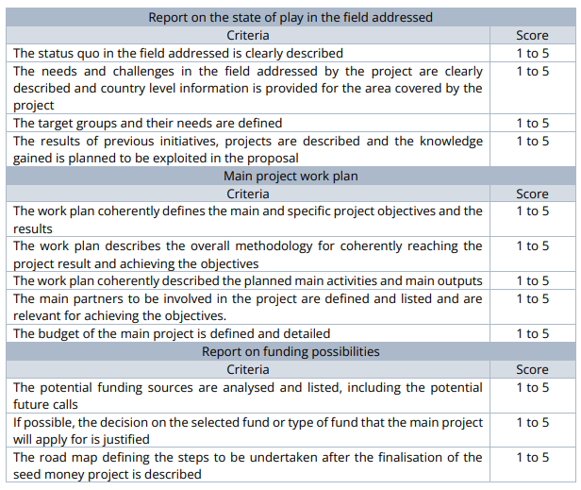
MA/JS Check of Activity part Quality criteria for mandatory outputs all criteria must reach a score of min. 3 Max. 2 rounds of completion

Slide 36
Completions Option 1: pending questions content-wise or missing documents, control certificates are ready: 1st round: max 10 days for completion 2nd round: max 5 days for completion Option 2: PPR and AfR have to be corrected incl. Corrections of control certificates max 20 days for completion

Slide 37
Financial completions to the PPR Some of the reasons - the AfR is not generated in JEMS - the AfR is not signed and stamped - bank details of the LP are missing or incomplete, the statement on project bank account is not uploaded - PR certificates are not included - payment dates for staff costs in partner reports are not reflected - the work of the national control is incomplete PPRs are reopened for completions PPRs successfully updated needs to be resubmitted

Slide 38
Payments to LPs and to PPs - payment (Interreg funds) to LPs in 10 days after the PPR is accepted (certified) - LPs to forward to PPs their share as per Art 6.L of the Partnership agreement - LPs to message to MA/JS proof (bank statements) of the Interreg funds transfer to PPs Retention period - 5 years from EOY of the date of the Interreg fund payment to the project (last payment)

Slide 39
Rejections After completion still no appropriate information on the following: ➢ the activities carried out by the project partnership during the seed money project implementation; ➢ quality of the mandatory outputs is not reaching the minimum level; ➢ clear and justifiable relation of the reported activities to the verified and reported expenditure of the PPs, etc. The requested amount for the respective part in the related AfR will not be paid to the LP.
Consequences
The LP was not able to appropriately fulfil its reporting obligations deriving from the subsidy contract.
The MA/JS is entitled to withdraw from the subsidy contract based on the prior decision of the Monitoring Committee. (Art. 14(2)m)

Slide 40
SMF call LP seminar
Project changes
On-line – 6 November, 2024
Simona Ene
Notes:
Title slide should include the title of the presentation, the presenter’s name, the date, place and name of the event.

Slide 41
Only minor changes allowed
Only MA/ JS PO confirmation is needed (no subsidy contract modification necessary)
Minor changes
Administrative changes
Minor content adjustment

Slide 42
Administrative changes
Type of modification | Action to be taken by LP
Change of the project management team | Informs the MA/JS PO about the change via email and updates the data in Jems
Change of the contact details of the LP/ PP | Informs the MA/JS PO about the change via email
Change of PP/ LP legal representative | ▪- Informs the MA/JS PO about the change via email ▪- Provides Annex A2_Proof of signature in case of LP legal representative change (electronic + original) ▪- Uploads the scanned Proof of Signature in Jems which will be clearly earmarked as being a new proof of signature!

Slide 43
Administrative changes
Type of modification | Action to be taken by LP
Change of LP bank account | - Informs the MA/JS PO about the change via email ▪- Provides Annex A1.1 or A1.2_Bank account statement (electronic + original) ▪- Updates the data in Jems and uploads the Bank account statement
Legal succession The legal succession of the LP (Article 11 of the SC) or PP is considered an administrative change and not a partner change if, based on the relevant legal act, it is proved that the new legal entity is the legal successor taking fully the duties and obligations of the predecessor, as well as it fulfils the partner eligibility criteria of the DRP. | - Informs the MA/JS PO about the change via email within 10 days from the date the legal act stating the legal succession enters into force and provides the legal act (in original language – to be checked by the relevant NCP) proving that the new legal entity is the legal successor of the previous one, taking over fully the duties and obligations of its predecessor * In case the legal representative or the LP bank account changes as well, documents and procedure described above will additionally need to be submitted / followed. * In case the legal succession is not confirmed by the relevant NCP, a partner change procedure will be followed. Documents for legal succession will be uploaded in Jems!

Slide 44
Minor content changes
Refer to:
timing, duration, location or format of activities.
timing, number (only increase or merging is allowed) or format of deliverables
Type of modification | Action to be taken by LP
Minor adjustments of the project content | Submits via email to MA/JS PO Annex B1_ Change Log File providing justification for the changes

Slide 45
Danube Region Programme
Managing Authority/ Joint Secretariat
Thank you for your attention!
https://www.linkedin.com/in/interregdanube/
https://www.facebook.com/InterregDanube/
Notes:
Thank you slide including the the contact information.

