Slide 1
PET – Pollution Evaluation Tool
An Open-Source Shiny Application for Scalable Quality Assurance and Exploration of Transnational River Basin Monitoring Data
S. Osten, S. Kittlaus, O. Zoboli

Slide 2
Agenda - PET
01
Context of development
Tethys project & MCC database background
02
Intents of development
Challenges of MCC-DB & PET goals
03
Developed Content
Two modes, features (& live demo)
04
Future Development goals
Ongoing refinement & vision
PET - Karlsruhe 2026 - RIVER BASINS Conference
2 / 29

Slide 3
01
Context of development
Tethys project & MCC database background
PET - Karlsruhe 2026 - RIVER BASINS Conference
3 / 29

Slide 4

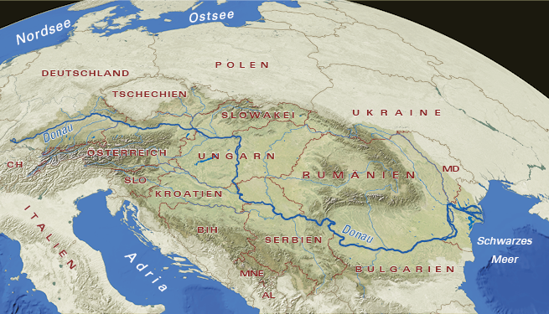
Context - The Tethys project
2024 - Launched as EU & Interreg project
13 PP
Project Partners
10 SP
Strategic Partners
CAPACITY BUILDING FOR
Monitoring - Chemical analysis - Data storage - Modelling of hazardous substances in the Danube river basin
OUTPUT
Multi-compartment concentration database (MCC-DB) for pathway-oriented modelling
+
Pollution Evaluation Tool
www.fgg-donau.bayern.de/die_donau/flussgebiet_donau
PET - Karlsruhe 2026 - RIVER BASINS Conference
4 / 29

Slide 5
Context - The MCC database
Tailor-made solution to support state-of-the-art emission modelling (e.g. MoRE)
57
Tables
35
CV registries
17
Import tables
7
Compartments
KEY FEATURES
Standardized CV metadata
Built-in import constraints
Role-based QA workflow
EU-reporting harmonized
FAIR & open-source
Visit the MCC-DB poster
by Steffen Kittlaus
PET - Karlsruhe 2026 - RIVER BASINS Conference
5 / 29

Slide 6
02
Intents of development
Challenges of MCC-DB & PET goals
PET - Karlsruhe 2026 - RIVER BASINS Conference
6 / 29

Slide 7
Intents - Challenges of the MCC database
X
!
|
Expert tool
Technical Skills required
Lack of Overview
Complex database architecture, that need to be understood
Import, validation, curation, maintenance & exploration are technically demanding
Information is spread across many tables, hiding the bigger picture
User-friendly Interface is needed!
PET - Karlsruhe 2026 - RIVER BASINS Conference
7 / 29

Slide 8
Intents - Claim & Goals of PET
Standardized and user-friendly processing system for data governance activities
✓
QA
⚒
Maintenance
☰
Processing
↗
Export
WITH
Less time
Fewer errors
No coding required
PET - Karlsruhe 2026 - RIVER BASINS Conference
8 / 29

Slide 9
03
Developed Content
Two modes, features (& live demo)
PET - Karlsruhe 2026 - RIVER BASINS Conference
9 / 29

Slide 10
Developed Content - Two modes of PET
✓
QA mode
⚙
Management mode
Measurement-centred evaluation of compartment-specific project data
Cross-compartment evaluation by controlled vocabulary and spatial dimension
Two filter systems linking the subject of evaluation across all import tables - ONE big picture
Filter incl. EU regulatory geodata (WFD water bodies, NUTS regions)
Data availability, Statistic, CV management, Export & Transfer
Comparison with already imported data
(DEMO TIME)
PET - Karlsruhe 2026 - RIVER BASINS Conference
10 / 29

Slide 11
Developed Content - QA: Feature overview
LINKAGE & FILTERING
PER-TABLE MODULES
ANALYTICS
Fast filter
Quick subject lookup
SUMMARY - all tables at a glance
Key table feature
Controlled vocabulary
WWTPs
Sites
Samples
Meas
Advanced filter
Precise filter building
Cross-table plots
LAmDet
ReEqsCl
Data SLS
Grid table plots
Completeness analysis
One big picture of the data - linked across all tables, contextualized for QA
PET - Karlsruhe 2026 - RIVER BASINS Conference
11 / 29

Slide 12
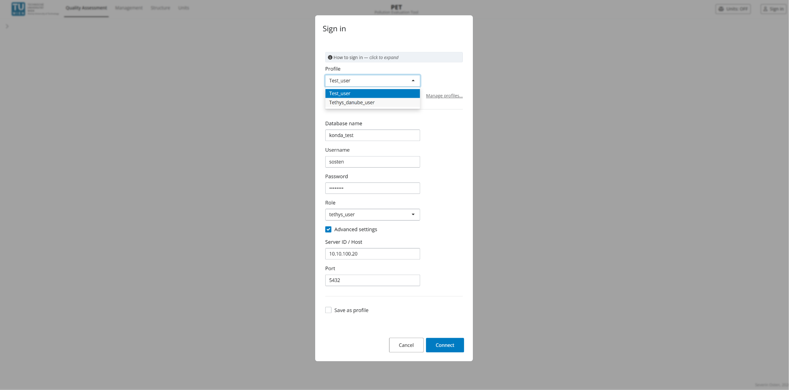
Developed Content - Compatibility & Authentication
Login / authentication overview
PET - Karlsruhe 2026 - RIVER BASINS Conference
12 / 29

Slide 13
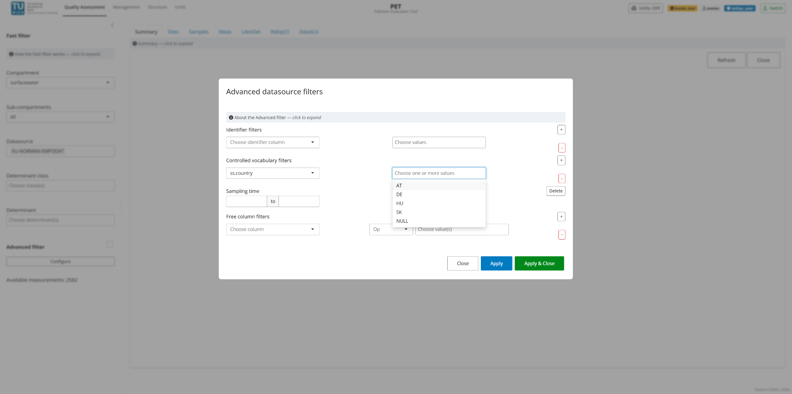
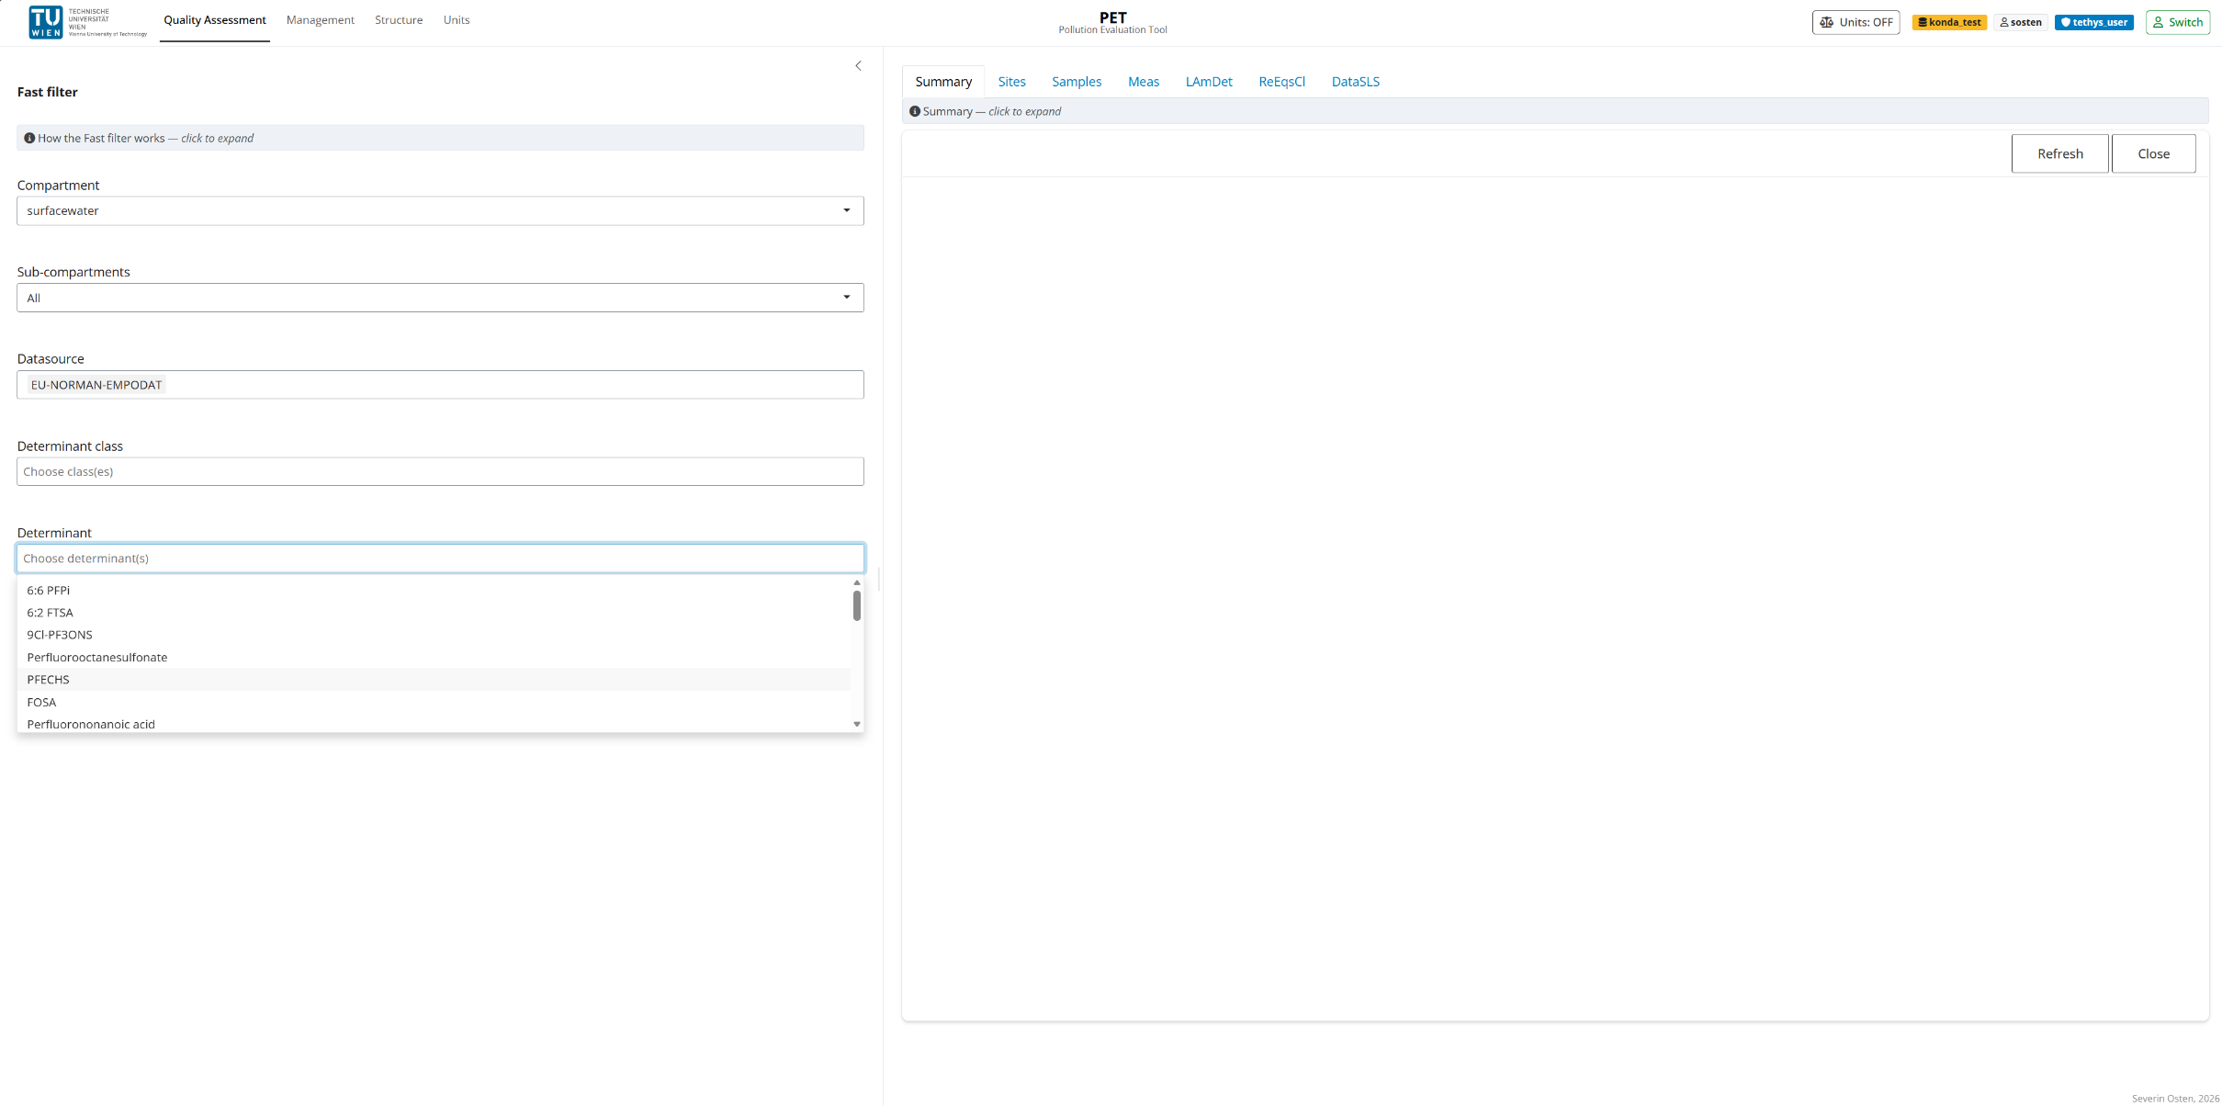
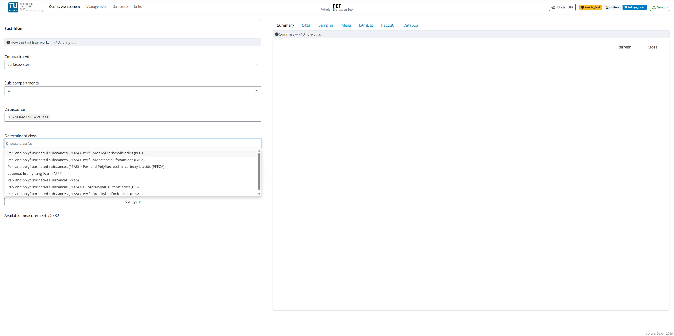
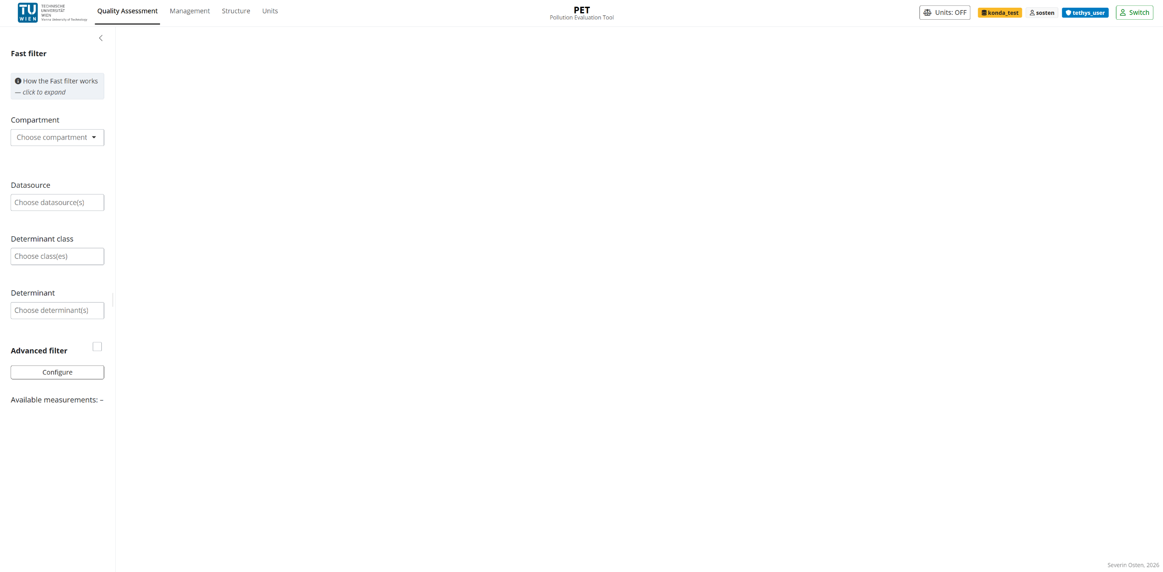
Developed Content - QA: Interface & Filter
Screenshot
PET - Karlsruhe 2026 - RIVER BASINS Conference
13 / 29

Slide 14
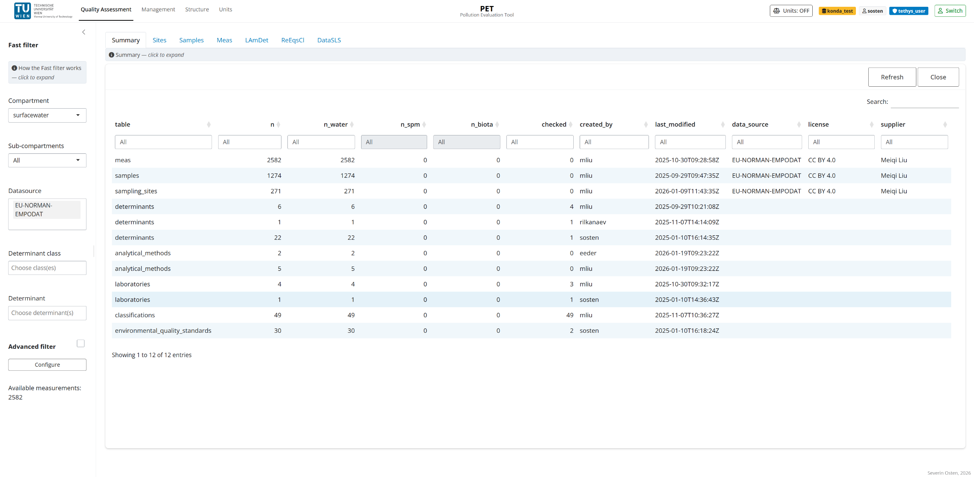
Developed Content - QA: Summary
Screenshot
PET - Karlsruhe 2026 - RIVER BASINS Conference
14 / 29

Slide 15
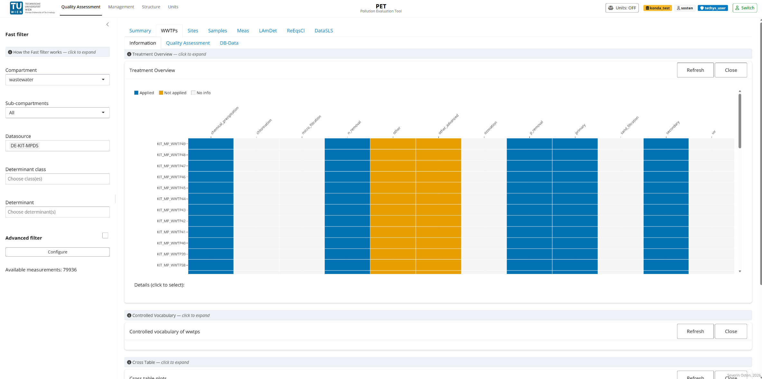
Developed Content - QA: WWTPs
Screenshot
PET - Karlsruhe 2026 - RIVER BASINS Conference
15 / 29

Slide 16
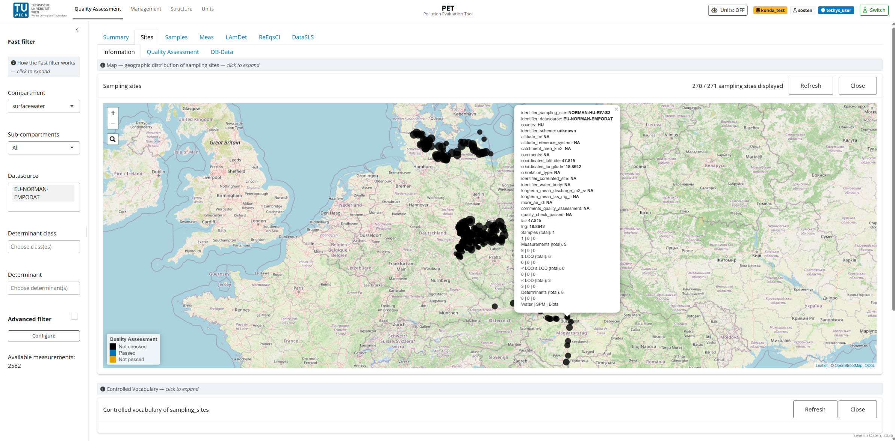
Developed Content - QA: Sites
Screenshot
PET - Karlsruhe 2026 - RIVER BASINS Conference
16 / 29

Slide 17
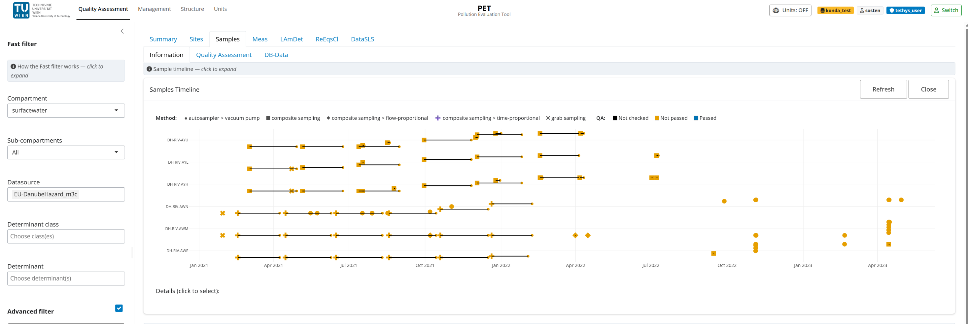
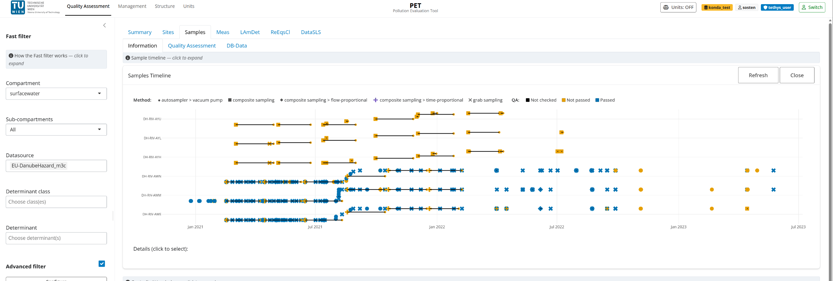
Developed Content - QA: Samples
Screenshot
PET - Karlsruhe 2026 - RIVER BASINS Conference
17/ 29

Slide 18
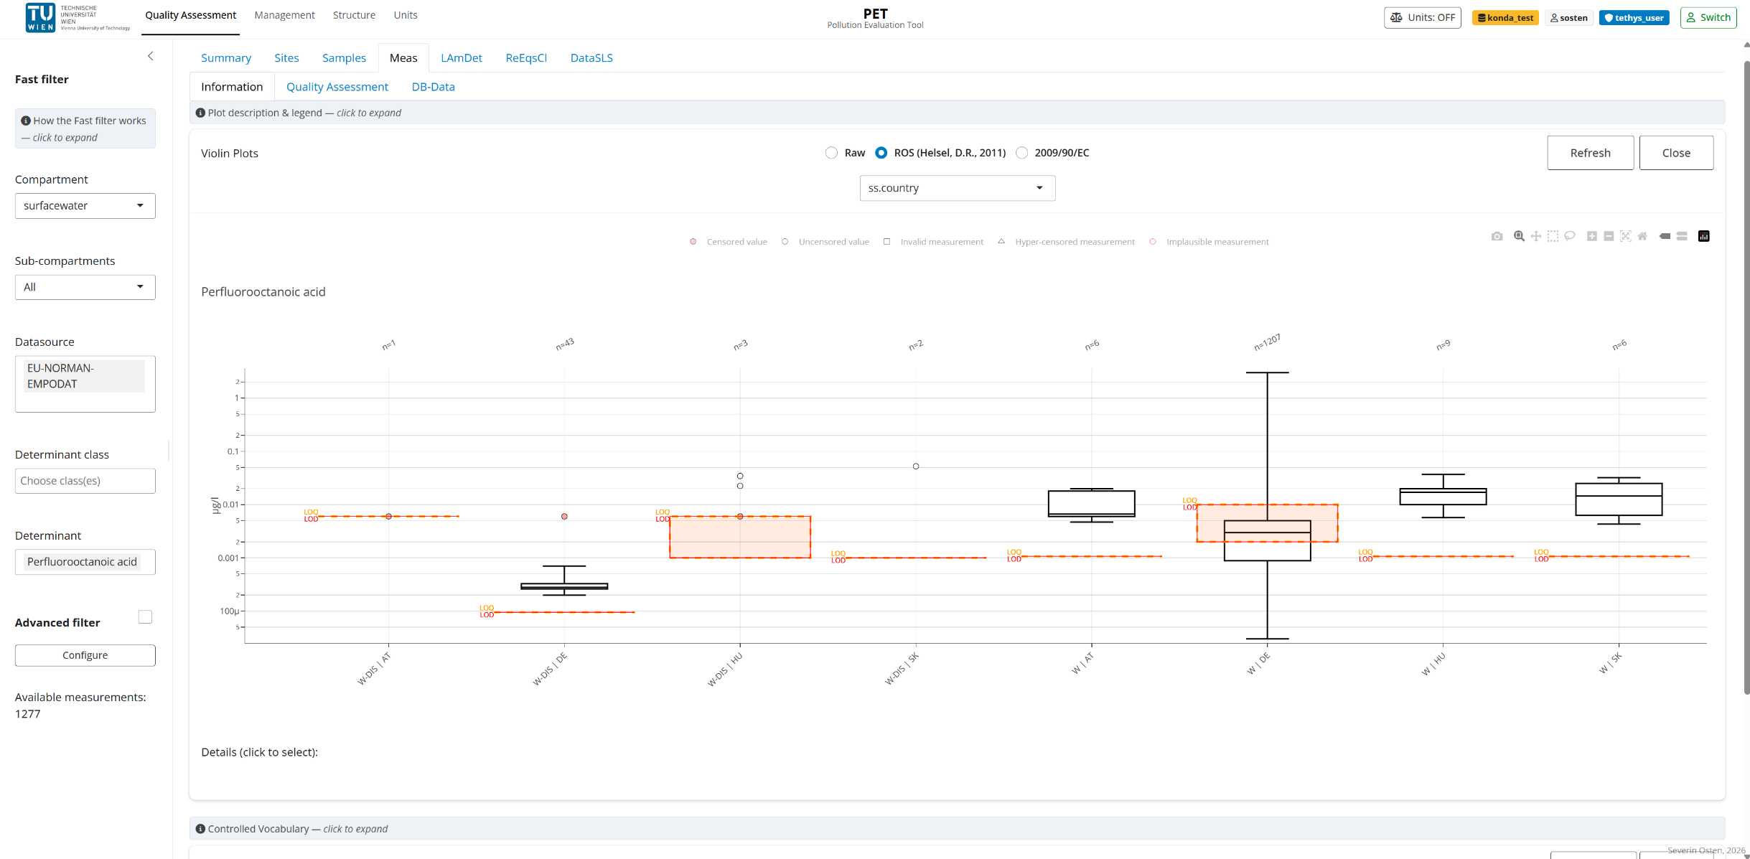
Developed Content - QA: Measurements
Screenshot
PET - Karlsruhe 2026 - RIVER BASINS Conference
18 / 29

Slide 19
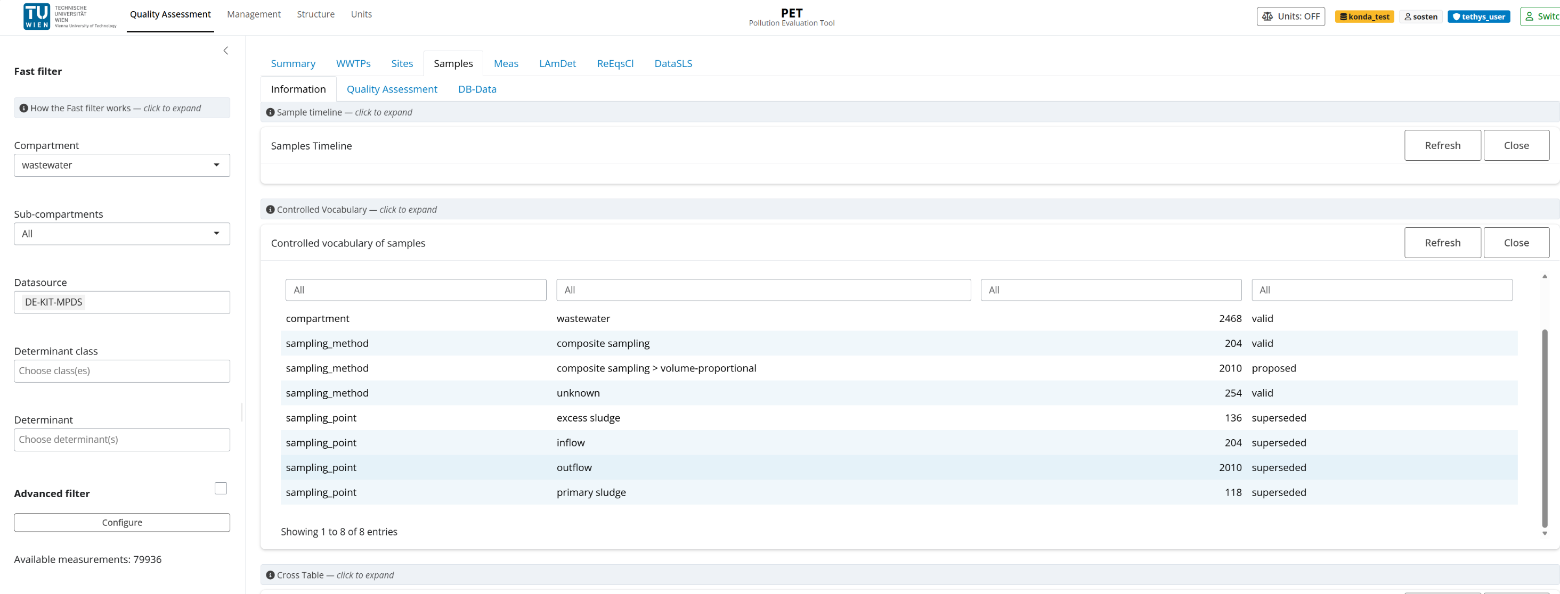
Developed Content - QA: Controlled Vocabulary
Screenshot
PET - Karlsruhe 2026 - RIVER BASINS Conference
19 / 29

Slide 20
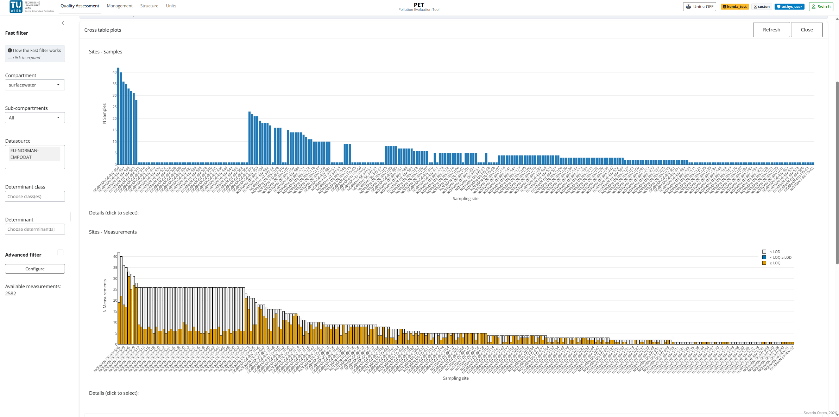
Developed Content - QA: Cross table plots
Screenshot
PET - Karlsruhe 2026 - RIVER BASINS Conference
20 / 29

Slide 21
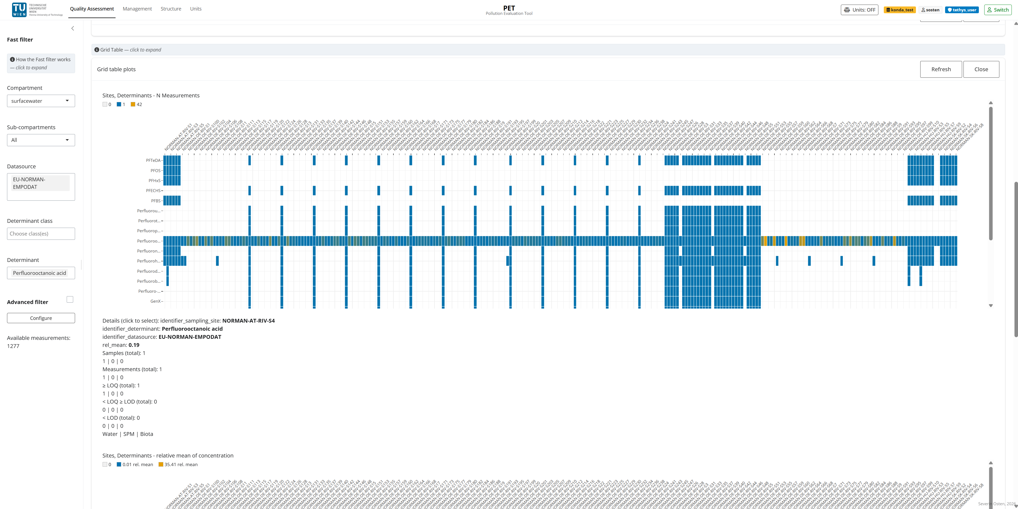
Developed Content - QA: Grid table plots
Screenshot
PET - Karlsruhe 2026 - RIVER BASINS Conference
21 / 29

Slide 22
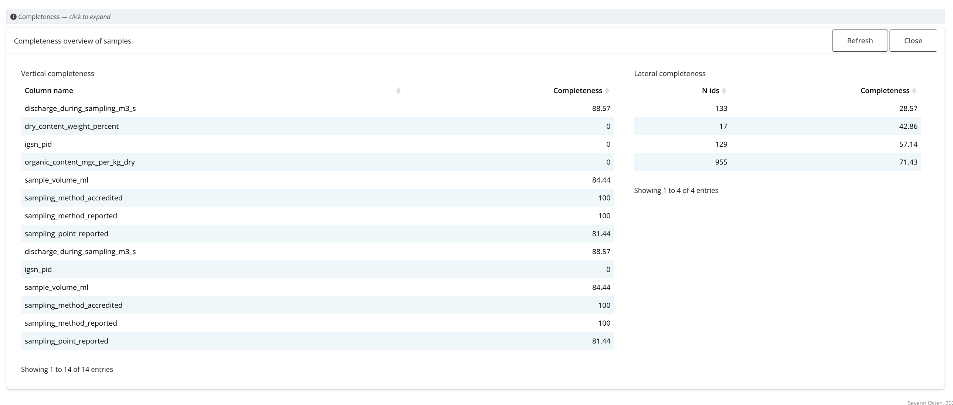
Developed Content - QA: Completeness analysis
Screenshot
PET - Karlsruhe 2026 - RIVER BASINS Conference
22/ 29

Slide 23
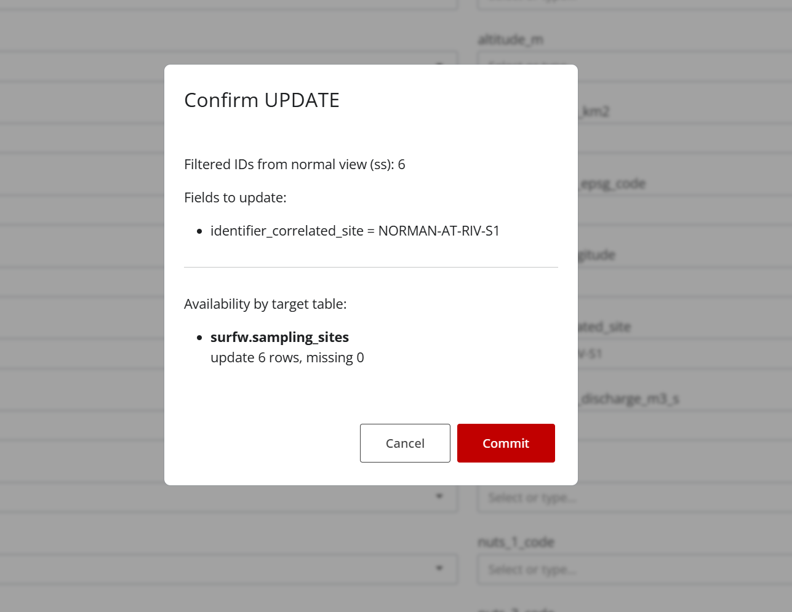
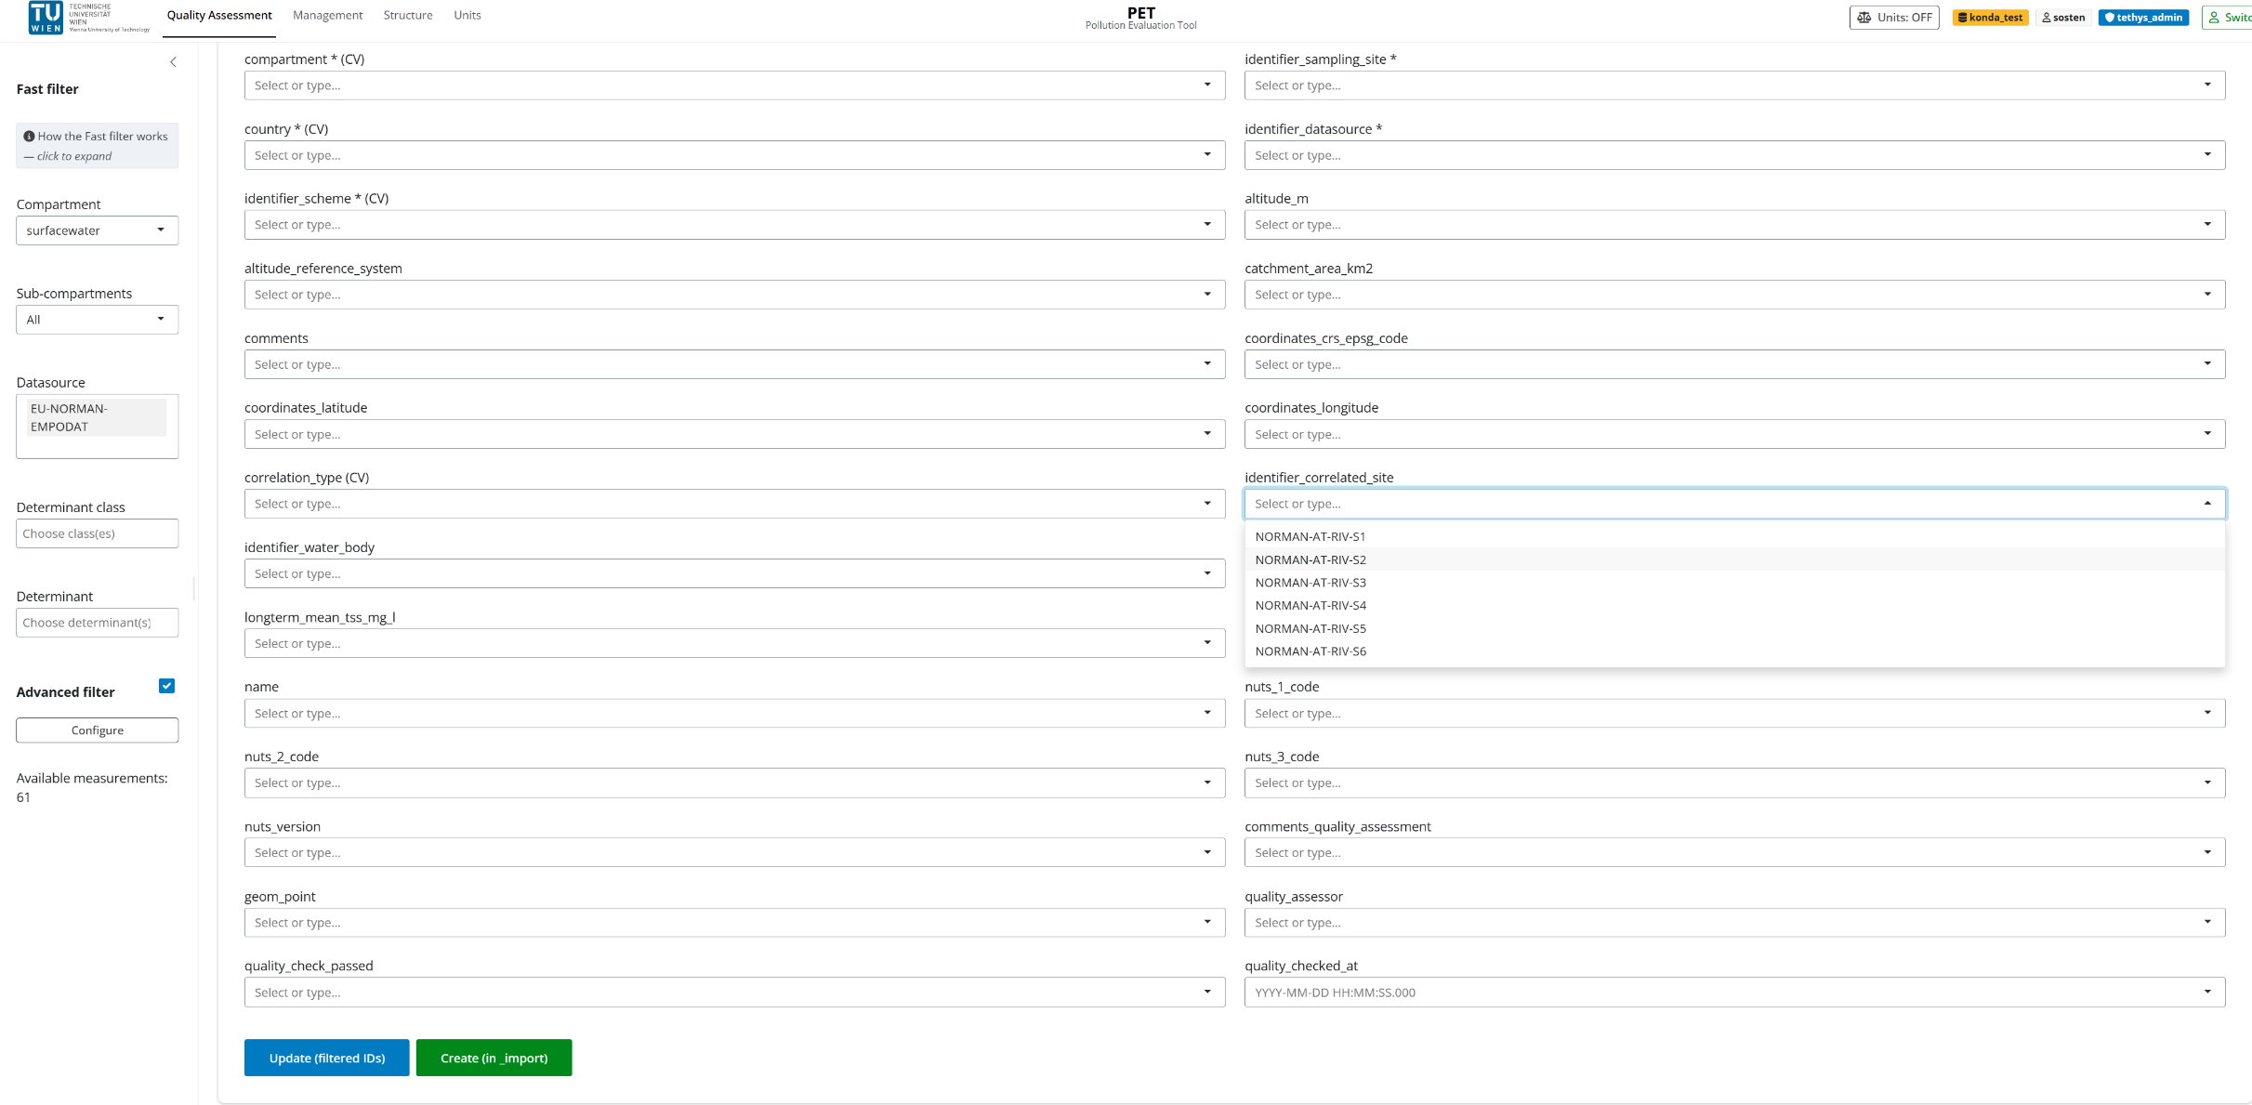
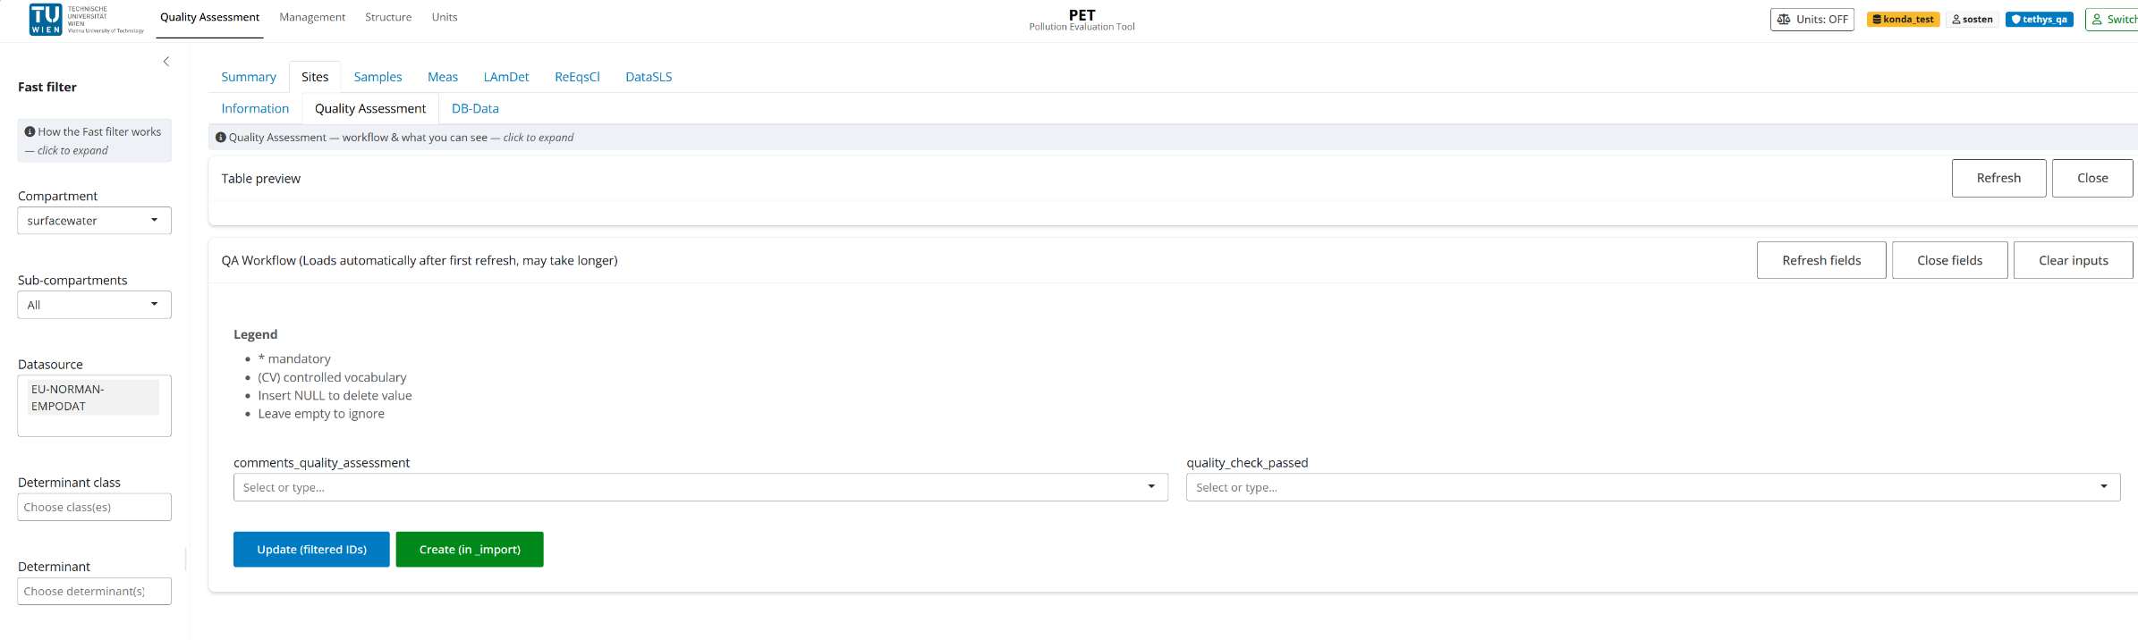
Developed Content - QA: Quality Assessment Workflow
Screenshot
PET - Karlsruhe 2026 - RIVER BASINS Conference
23 / 29

Slide 24
Developed Content - Management: Feature overview
Cross-compartment evaluation with spatial intelligence
◱
≡
↔
Advanced spatial & data filter
Summary module
Compartment comparison plot
WFD water bodies, NUTS regions, full CV-driven slicing
Data availability, Source, License and QA-Status
Side-by-side measurements across all compartments
PET - Karlsruhe 2026 - RIVER BASINS Conference
24 / 29

Slide 25
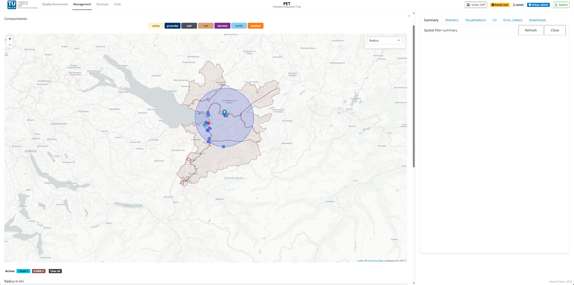
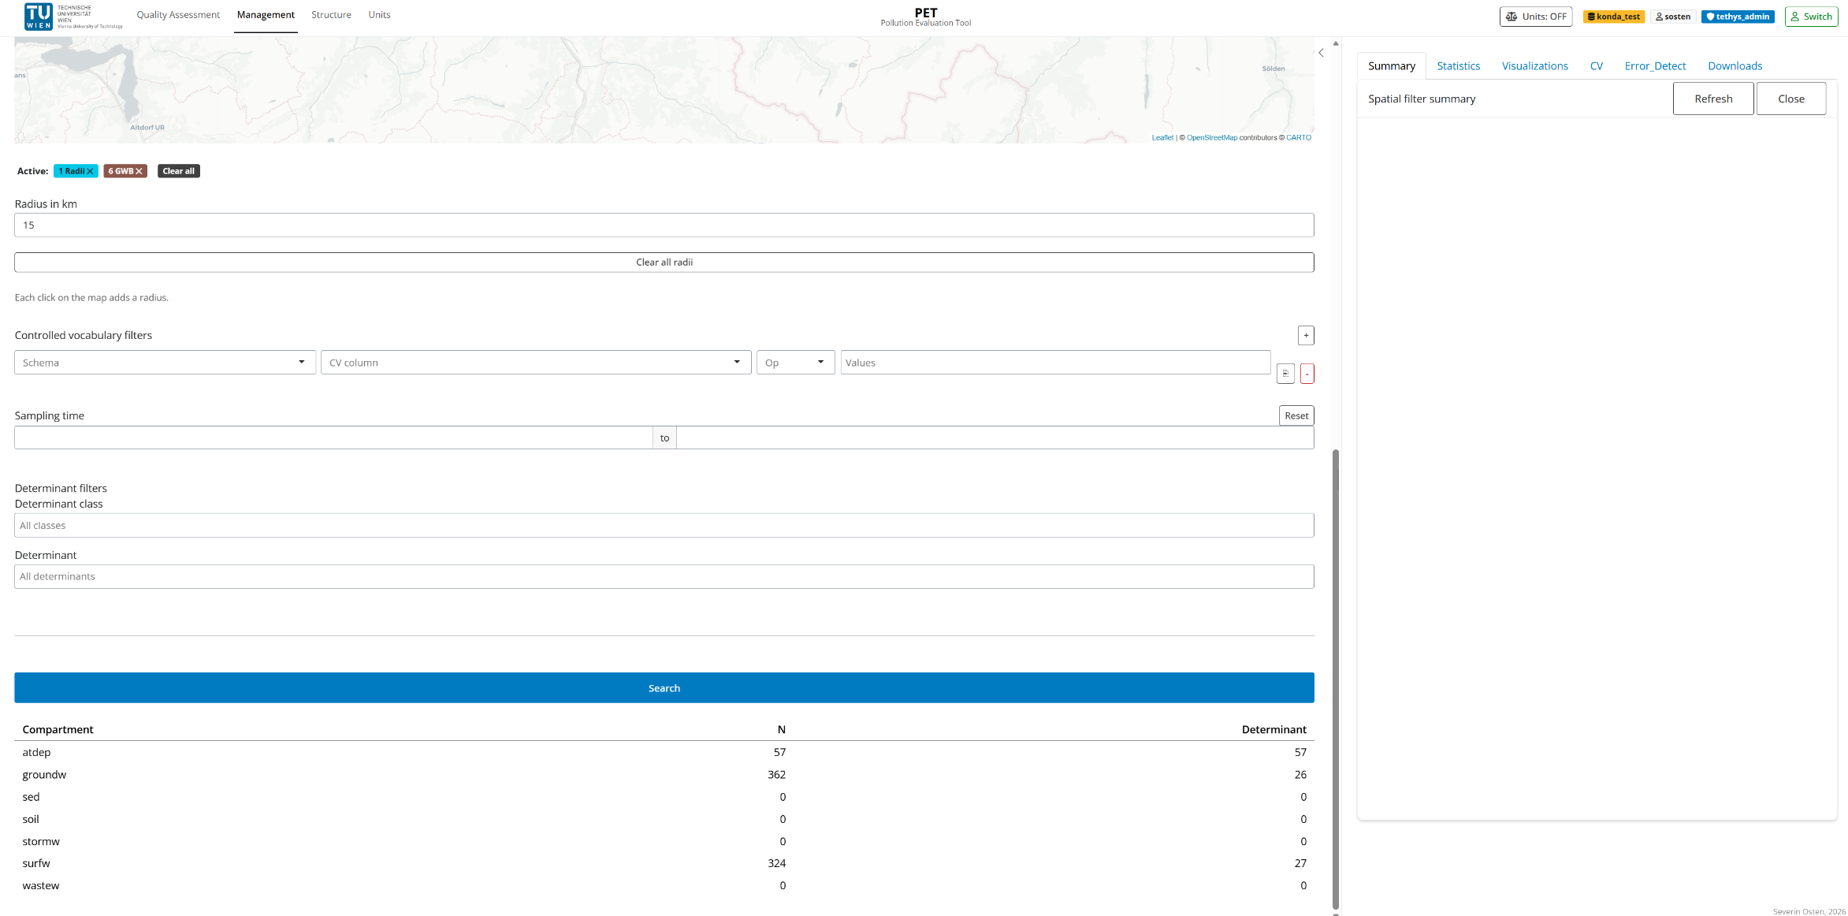
Developed Content - Management: Filter system
Screenshot
PET - Karlsruhe 2026 - RIVER BASINS Conference
25 / 29

Slide 26
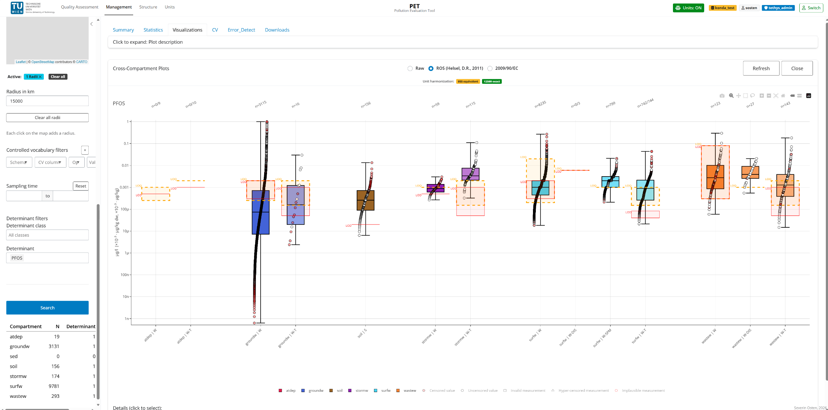
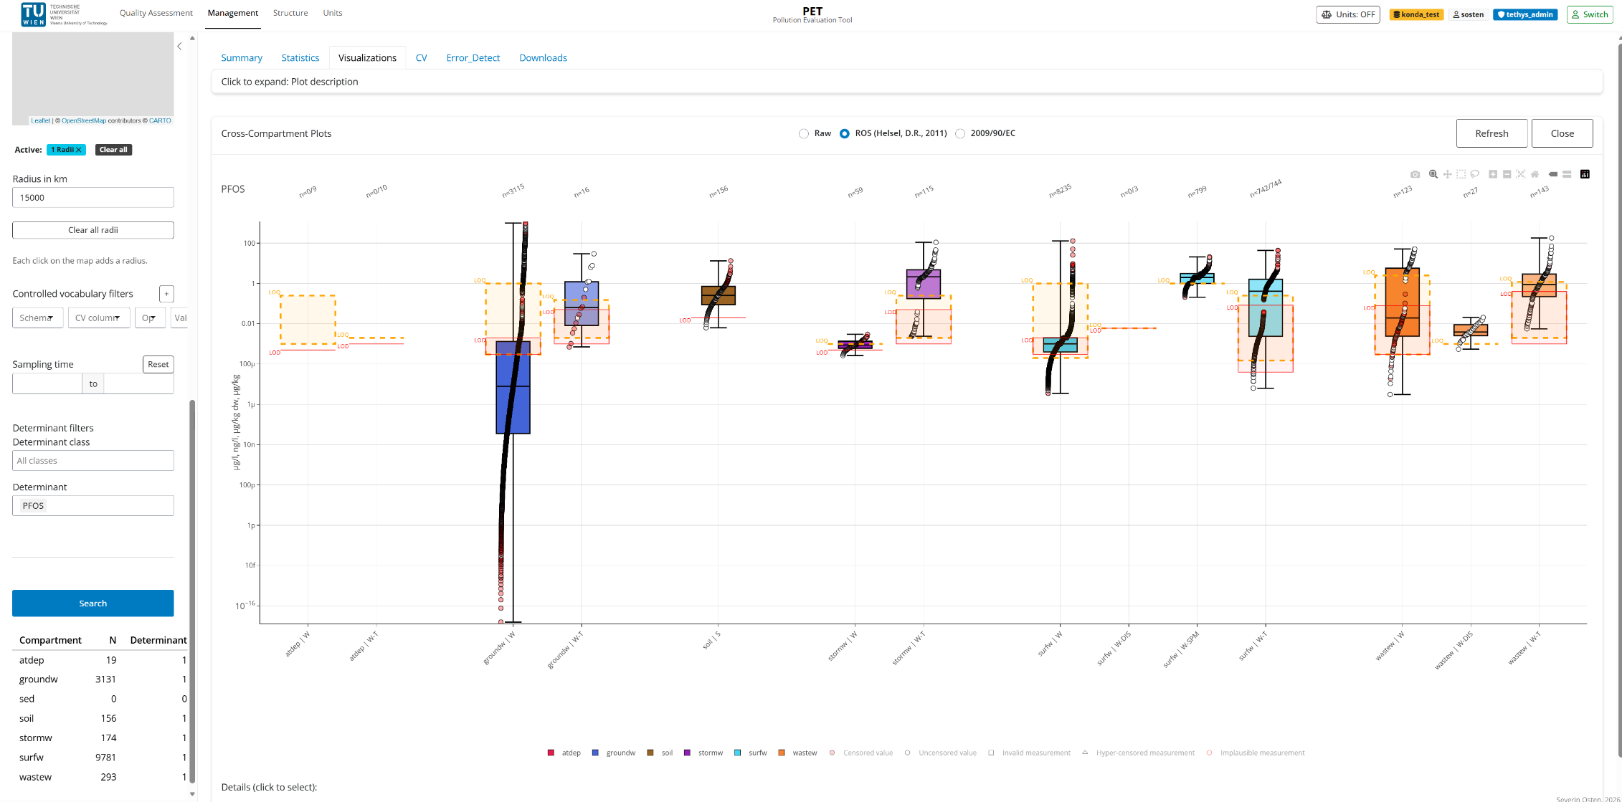
Developed Content - Management: Compartment comparison
Screenshot
PET - Karlsruhe 2026 - RIVER BASINS Conference
26 / 29

Slide 27
04
Future Development goals
Ongoing refinement & vision
PET - Karlsruhe 2026 - RIVER BASINS Conference
27 / 29

Slide 28
Future Development
From pilot to a lasting transnational governance tool
1
2
3
4
Refinement
Task support
Insights
Data exchange
Bug fixing, usability, feature requests
Modelling & management workflows
Availability, quality, statistics, CV mgmt
Export & transfer across databases
VISION
PET as the user-friendly gateway to transnational hazardous-substance data
PET - Karlsruhe 2026 - RIVER BASINS Conference
28 / 29

Slide 29
Thank you for your attention
PET - Pollution Evaluation Tool
Severin Osten
Questions & discussion welcome
PET - Karlsruhe 2026 - RIVER BASINS Conference
29 / 29

